Slide 1
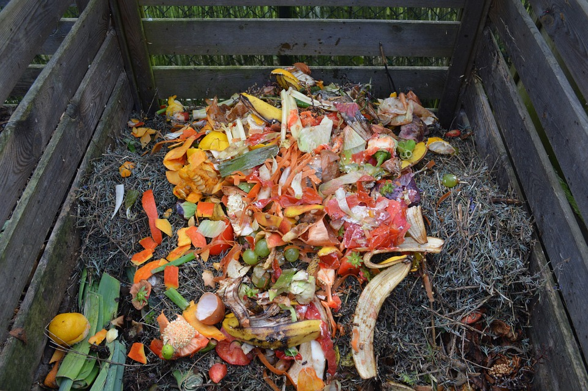
Model Compost Procurement Policy

Slide 2
Presentation Outline
Part I: Background
What is a Compost Procurement Policy?
Goals
Model Policy Development
Part II: The Model Policy
Purpose
Procurement Requirements
Compost Sourcing
Reporting
Part III: Additional Resources
Links to Model Policy
Helpful Sources
Contact Information

Slide 3
What is a Compost Procurement Policy?
Compost procurement policies require or encourage in some manner that municipalities purchase and use finished compost products in public projects such as landscaping, construction, and stormwater management.

Slide 4
Goal of the NRDC/ELI Model Compost Procurement Policy
Support municipalities in their efforts to divert food scraps and other organic materials from their landfills and incinerators.
Help cities realize the myriad of economic and environmental benefits that can be gained from a compost procurement policy.
Reduce the time and effort needed to create a compost procurement policy (as compared to starting from scratch).
Offer a model that can be used by a wide range of cities.

Slide 5
Model Policy Background
Developed by the Natural Resources Defense Council and the Environmental Law Institute in 2021 pursuant to their work with the Nashville Food Waste Initiative.
Based on extensive research on best practices from around the United States.
Designed as an adaptable tool that can be tailored to needs of individual municipalities, including small and mid-size cities.
Structured as companion pieces—an off-the-shelf version and a version with commentaries:
Annotated version of the model policy includes commentary that provides background and alternative approaches for key provisions.

Slide 6
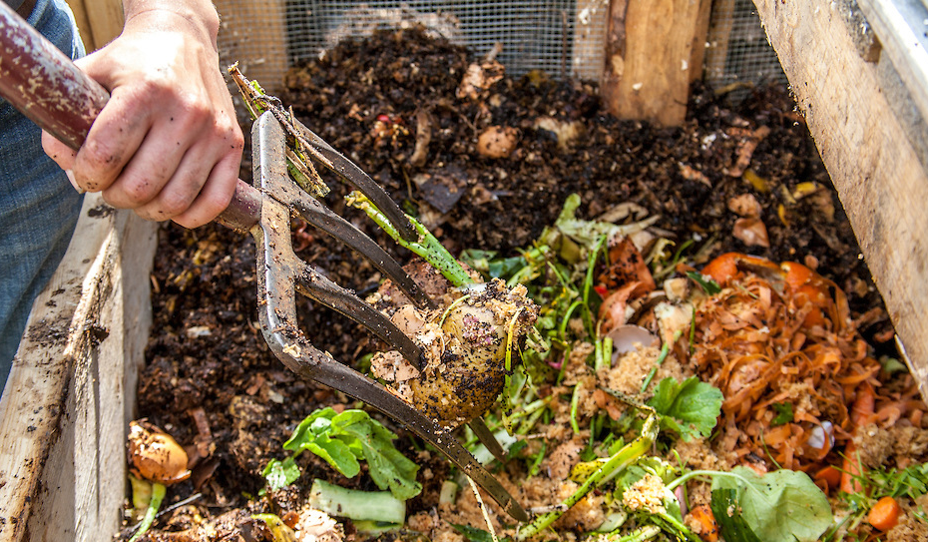
The NRDC/ELI Model Policy
This Photo by Unknown Author is licensed under CC BY-NC-ND

Slide 7
Economic Benefits
Requiring the purchasing of finished compost products can increase demand for compost and increase business for local compost suppliers.
Diverting organic waste to be composted can reduce costs associated with landfill disposal.
Growing the compost market may result in the development of new compost processing facilities, which in turn may provide more jobs.
Applying compost increases soil nutrient and water retention, which may reduce demand for irrigation and fertilizer, thereby reducing operational costs.

Slide 8
Environmental Benefits
Diverting organic waste from landfill disposal reduces greenhouse gas emissions by minimizing methane emissions from landfills—and may ultimately mitigate the need for new landfill construction.
Cycling carbon and nutrients back into soil through compost application conserves resources and improves soil quality.
Adding compost to soil helps prevent erosion and stabilize land.
Adding compost to soil increases the ability of soil to retain water, thereby reducing stormwater runoff and reducing reliance on irrigation.
Adding compost to soil replenishes nutrients and increases nutrient retention, reducing reliance on chemical fertilizers, which are often produced using fossil fuels.
Using compost in lieu of chemical fertilizers reduces water pollution that can result from fertilizer application and subsequent nutrient runoff.
This Photo by Unknown Author is licensed under CC BY-NC-ND

Slide 9
General Policy
Municipality shall purchase compost for use in public projects in which compost is an appropriate material, provided it is not cost prohibitive to acquire.

Slide 10
Entities Covered
Applies to municipal entities (e.g., departments, agencies).
Encourages quasi-governmental or semiautonomous entities (e.g., boards, commissions) to adopt policy.
Encourages private entities to follow policy.
Factors in determining entities that should be subject to a compost procurement policy:
Issuing municipality’s scope of authority;
Political constraints; and
Budgetary constraints.

Slide 11
Key Definitions
“Compost” means solid waste that has undergone biological decomposition of organic matter, has been disinfected using composting or similar technologies, and has been stabilized to a degree that is potentially beneficial to plant growth and that is suitable for use as a soil amendment, artificial topsoil, or other similar applications.
“Cost prohibitive” means the product purchasing cost exceeds by more than 10 percent the cost of another product that would serve the same purpose.
“Procurement” means buying, purchasing, renting, leasing, or otherwise acquiring any supplies, services, or construction. It also includes all functions that pertain to the obtaining of any supply, service, or construction, including description of requirements, selection and solicitation of sources, preparation and award of contract, and all phases of contract administration.
Note: Municipalities may want to source definitions from their own local or state codes and policies to promote consistency.

Slide 12
Alternatives To Cost Prohibitive Standard
Modified definition of “cost prohibitive” that increases or lowers the 10 percent standard—or gradually ramps it up.
“Whenever practicable” standard, which allows municipality to take into account factors in addition to purchasing cost (e.g. Sustainable Purchasing Policy of Sacramento, California).
“Price preference” or “bid discount” approach (e.g. Berkeley’s Environmentally Preferable Purchasing Policy).
Percentage of purchases requirements, whereby a certain portion of money spent or product purchased is allocated to compost (percentage can be ramped up over time).
Note: Model policy adopts a “cost prohibitive” standard defined as the cost of compost exceeding the cost of an alternative product by more than 10 percent.

Slide 13
Procurement Requirements Apply to:
LANDSCAPING
CONSTRUCTION
ROAD AND HIGHWAYS
LOW-IMPACT DEVELOPMENT AND GREEN INFRASTRUCTURE

Slide 14
Compost Sourcing and Quality Requirements

Slide 15
Compost Sourcing
Compost must be locally sourced, if available.
“Locally produced compost” is defined as compost that is produced in the same region where is it is being used.
If locally produced compost is not available, compost must be sourced from outside the region, with preference given to products sourced as close as possible to municipality.
Proof that locally produced compost was not available at the time of purchase (or was cost-prohibitive) shall be documented and included in the annual reports.

Slide 16
Alternative Or Additional Sourcing Requirements
Temporal: Some local governments provide an exception to the requirement that local governments use compost in their projects, if compost products “are not available within a reasonable period of time.” (State of Washington)
Locally Generated: Some municipalities may preference compost that is made using feedstocks generated within the region. (Sacramento and Berkeley)

Slide 17
U.S. Composting Council Seal of Testing Assurance (STA) Program
Compost must be purchased from U.S. Composting Council STA Program-certified manufacturers.
Technical data sheets from composting manufacturers that detail test results for each compost shipment received must be kept on file and included in annual compost procurement report.
Note: Some local governments include language specifying a maximum amount of time that can pass between when the testing is performed and when the compost is used.

Slide 18
reporting

Slide 19
Reporting
Annual reporting requirements:
Name of the municipal entity;
Volume of compost purchased throughout the year and total amount spent on compost;
Information about the source of the compost and proof of its STA certification; and
Recommendations for how to increase the percentage of purchased compost in the future.
Municipal procurement office reviews reports, tracks progress, shares information with the public.
Tracking and reporting requirements help to:
gain credibility by demonstrating how the jurisdiction is “leading by example”
identify opportunities to improve the sustainable procurement program (Urban Sustainability Directors Network, p. 8)

Slide 20
Additional Resources

Slide 21
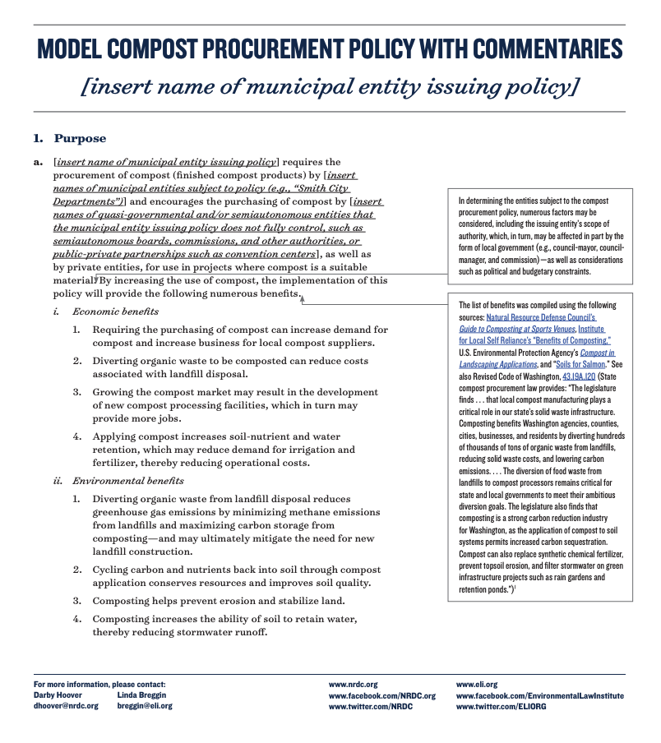
Dive into the Model Policy
Annotated Model Compost Procurement Policy: https://www.eli.org/research-report/model-compost-procurement-policy-commentaries
Commentary is provided explaining the benefits of key provisions and alternative approaches, as well as links to examples—all of which are intended to help guide stakeholders and policymakers in tailoring the policy to the unique circumstances of their region
Unannotated Model Compost Procurement Policy: https://www.eli.org/research-report/model-compost-procurement-policy-commentaries
This template without commentaries can be used as an “off-the-shelf” model and was developed to be easily adapted for individual municipalities.

Slide 22
Helpful Sources
Nashville Food Waste Initiative: https://urbangreenlab.org/nashville-food-waste-initiative/
NRDC Food Matters: https://www.nrdc.org/food-matters
ELI Food Waste Initiative: https://www.eli.org/food-waste-initiative/food-waste-prevention-recovery-and-recycling
U.S. Composting Council’s Model Compost Rules: https://cdn.ymaws.com/www.compostingcouncil.org/resource/resmgr/images/advocacy/Model_Compost_Rule.pdf
U.S. Composting Council’s Compost Use Applications Factsheets: https://compostfoundation.org/Return-on-Investment

Slide 23
For More Information Please Contact
LINDA BREGGIN
breggin@eli.org
www.eli.org
www.facebook.com/EnvironmentalLawInstitute
www.twitter.com/ELIORG
DARBY HOOVER
dhoover@nrdc.org
www.nrdc.org
www.facebook.com/NRDC.org
www.twitter.com/NRDC

