Slide 1
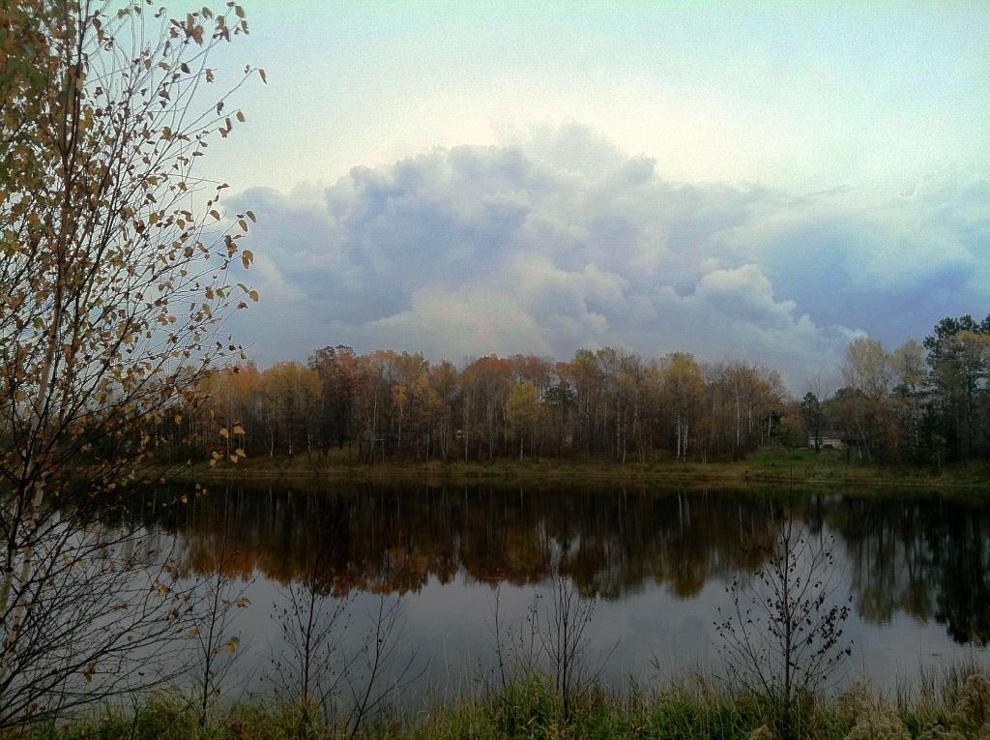
Using Alum Treatment and Watershed Management to Improve Water Quality in a Small Lake on the Fond du Lac Reservation
Kari Jacobson Hedin
Watershed Specialist
Fond du Lac Environmental Program
Office of Water Protection
Nancy Schuldt
Water Projects Coordinator
Fond du Lac Environmental Program
Office of Water Protection

Slide 2
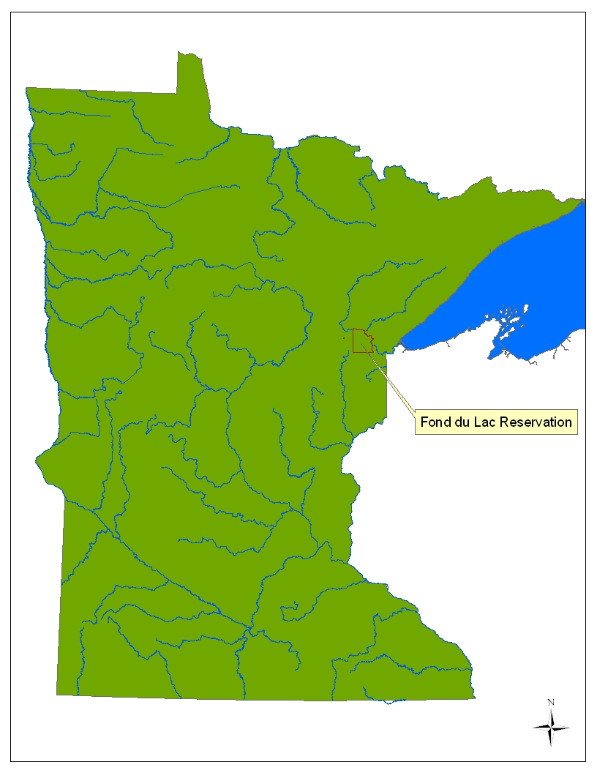

Fond du Lac Reservation
Notes:
I work for the Fond du Lac Band of Lake Superior Chippewa
Ojibwe people thrived for generations in and around Lake Superior
St. Louis River forms northern border.
“Head of the Lake”
mostly in the Lake Superior Watershed
Reservation established by the Treaty of La Pointe in 1854
1,353 Band members live on the Reservation, and an additional 2,735 live elsewhere
Signatories to the 1854 Ceded Territories, maintain hunting, fishing and gathering rights
Fond du Lac has TAS for water quality and NPS – our new building

Slide 3
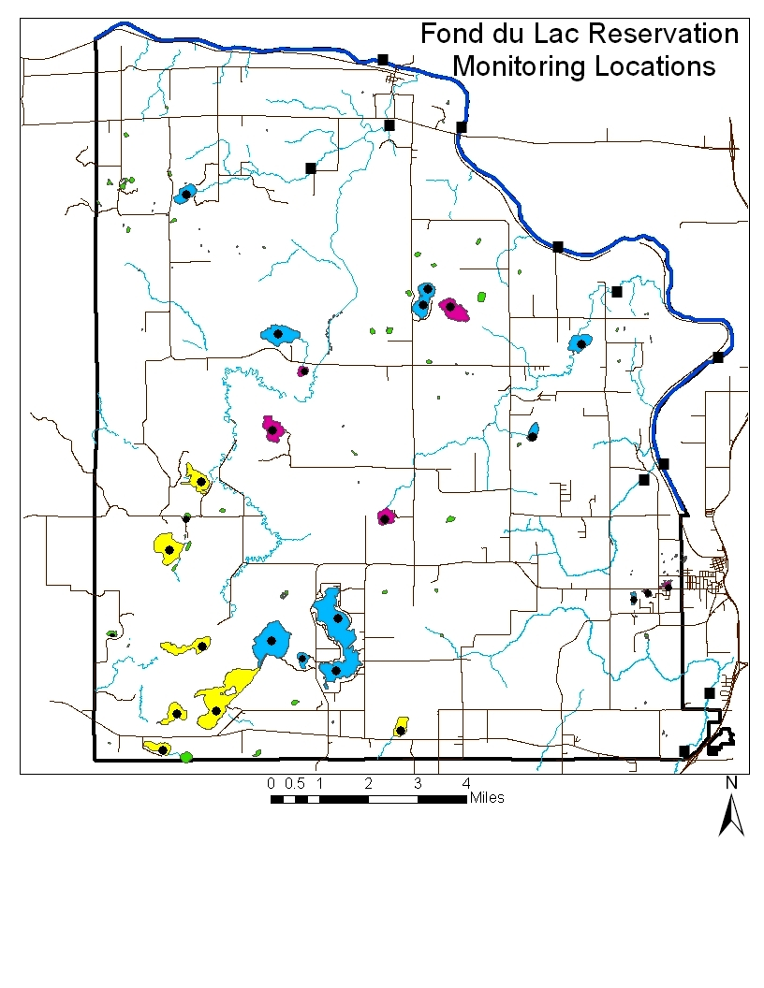
Fond du Lac’s Water Resources:
23 lakes
6 streams
St. Louis River
47% of land base is wetland
Third Lake
Notes:
Water resources: on slide
106:
since 1999
Primary Fish lakes like Third get sampled 4 times a year to capture seasonal variability
WQ standards designed to be protective.
WQ good, except for Third Lake (cue)

Slide 4
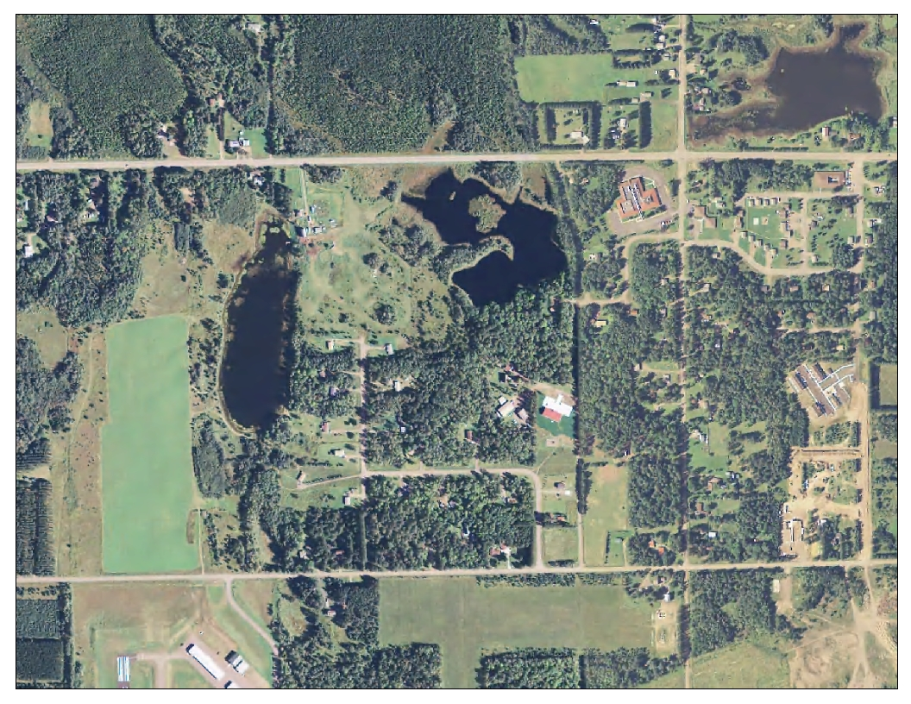
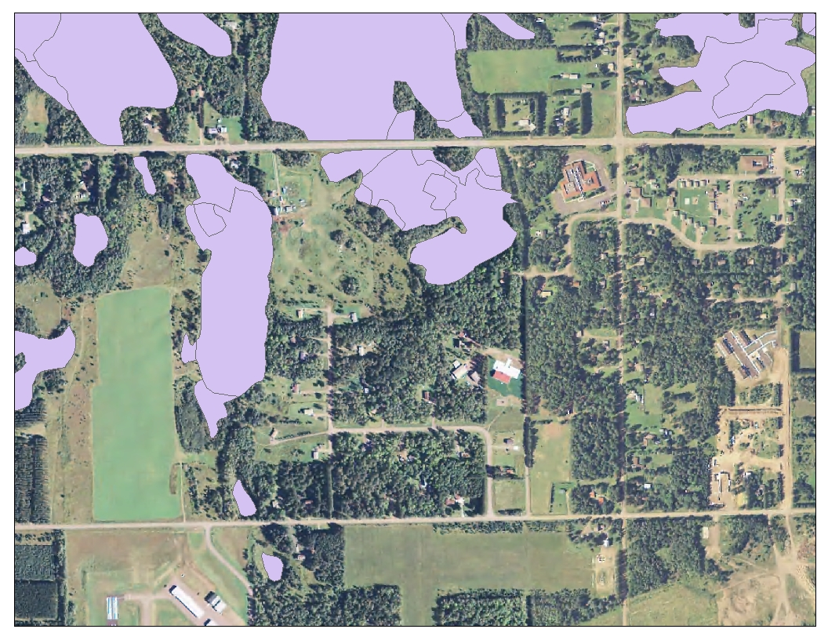
Notes:
Background on Third Lake:
Three lakes (2 shallow open water wetlands, one deep)
Farm, airstrip, historical farming, isolated (non-jurisdictional) wetlands (show overlay)
Rare upland here, hence farming, also aquifer
Third Lake
Primary fisheries lake
5.4 ha (14 acres), about 6m or 20 ft deep
Dimictic
Isolated basin – easier to control external inputs of P for this project, only need to address immediate watershed

Slide 5
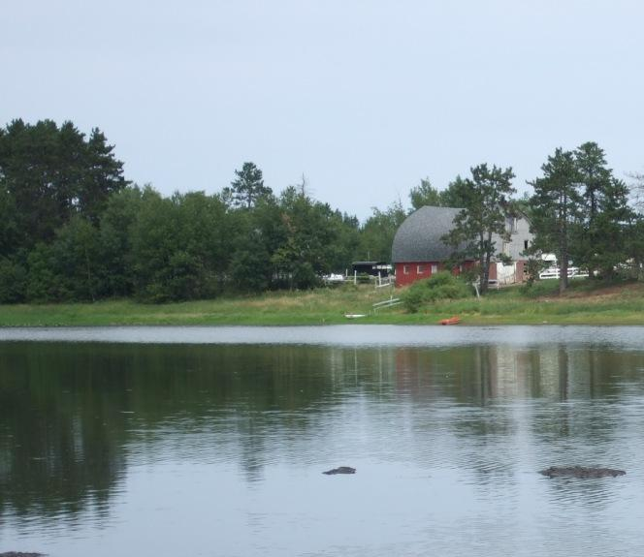
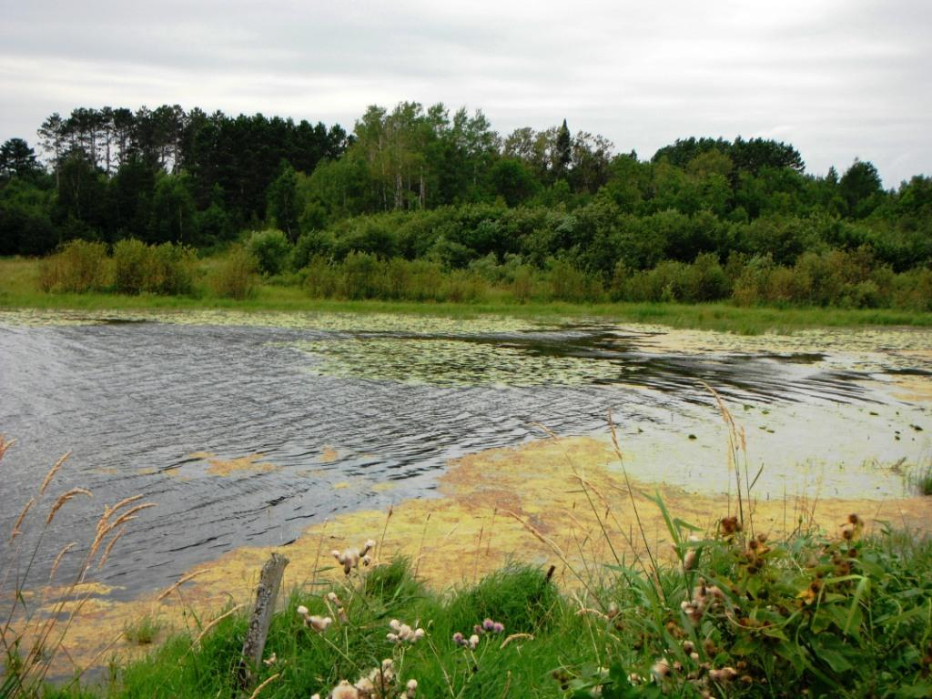
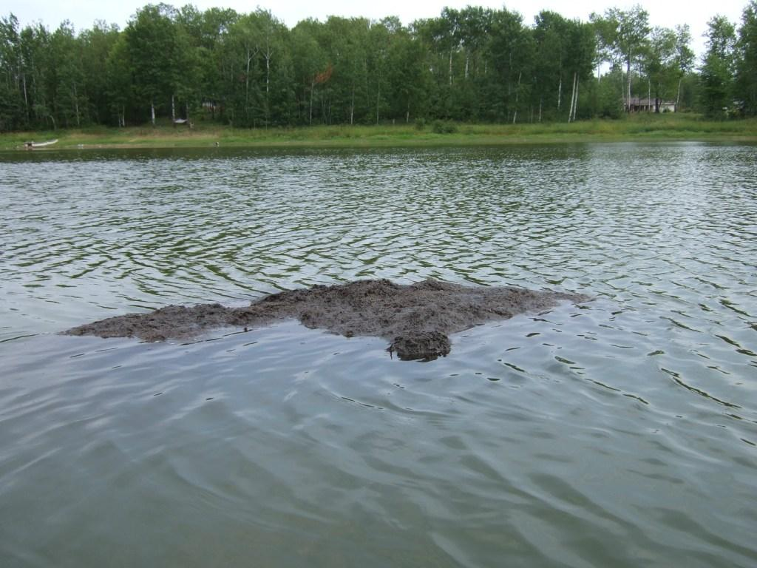
Notes:
Basis for receiving grant:
NPS Pollution Assessment Report and Management Program and 305 (b) WQ report:
Third Lake has two significantly impaired designated uses due to nutrient enrichment:
primary contact recreation
aquatic life
What We See (10 yrs monitoring):
summer algal blooms
high pH (>9)
Reduced water clarity and higher than TP compared to similar lakes on the Reservation
Turbidity readings higher than any of the other monitored water bodies on the Reservation.
The zooplankton community exhibits reduced diversity, high abundance and smaller organisms which may indicate stressors.

Slide 6
EPA Section 319 Competitive Grant
Project Goals
Understand historical changes to Third Lake ecology
Work with horse farm owner to reduce external nutrient inputs
Apply alum to reduce internal nutrient recycling
Targeted monitoring to note effects of nutrient reduction
90% reduction of total phosphorus in the water column due to external and internal nutrient load reductions
Educate Band members and Third Lake homeowners and learn what they know about the lake
Notes:
Goals outlined in the proposal:
A good relationship with landowners – we want their input.
Let them know the lake is unhealthy and how we can work together to improve it.
We assume the horse farm is the biggest single nutrient input – want a good working relationship with the farmer.
Want to control external nutrient inputs, but in a way that isn’t heavy –handed (collaboration, cost-share).
Reduce internal nutrient cycling by applying aluminum sulfate (Al₂(SO₄)₃, or alum.
Under anoxic conditions on the lake bottom, phosphorus is released from lake sediments and into the water column, making this nutrient available to algae. Alum reacts with phosphorus to form an aluminum phosphate compound, which is in a precipitate form called floc. The phosphorus bound up in the floc is unavailable for use by algae, and the floc layer on the lake bottom serves as a barrier that prevents further phosphorus release from the sediments. The effectiveness of alum treatments usually lasts around 10 years, but since external nutrient loads on Third Lake will most likely be under control by then, the system will hopefully not revert back to an impaired state.
Monitor the prior conditions and after effects of controlling nutrient loads to meet goals.

Slide 7
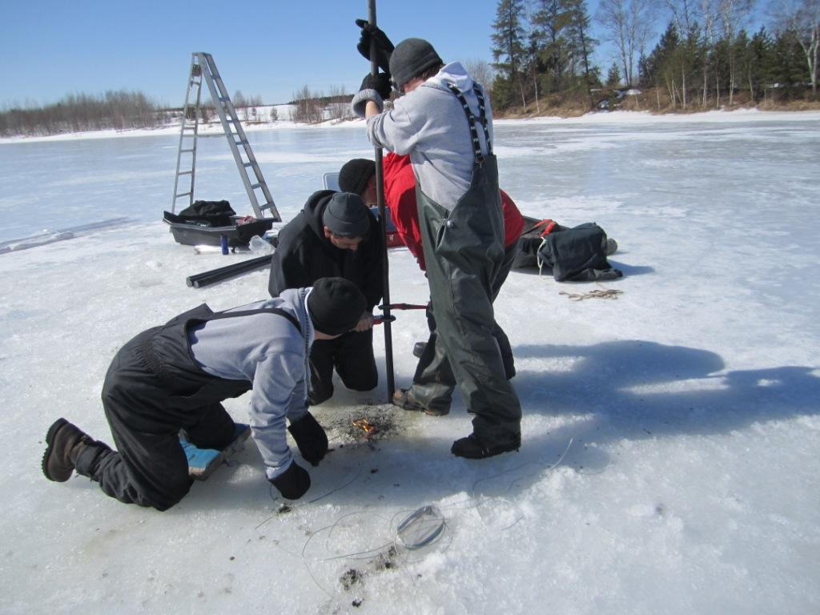

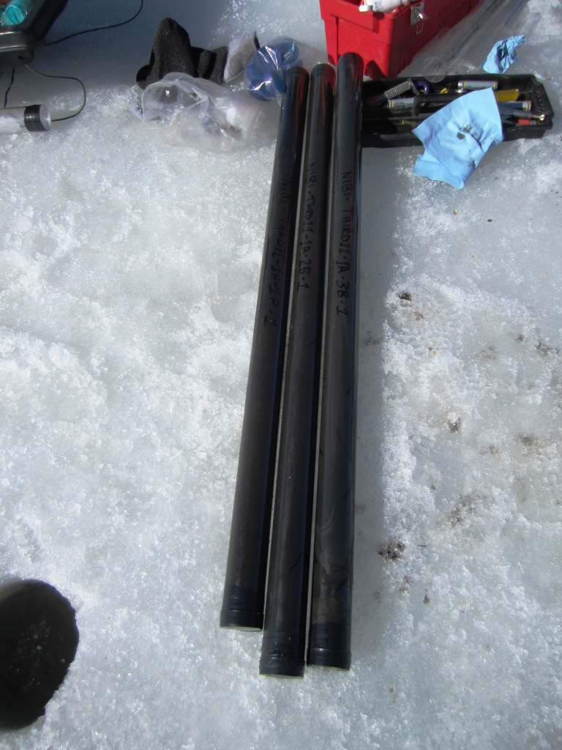
Lake Sediment Coring
Notes:
Lake coring for paleoecology.
Natural Resources staff experienced at this
Contracted with LacCore at U of Minnesota. They have experience analyzing lake cores all over the world.
Lead-210 activity was analyzed to develop a dating model and determine the sediment accumulation rate over the past 150-
200 years and diatoms in the sediments were analyzed to reconstruct changes in lake ecology and trophic state.

Slide 8
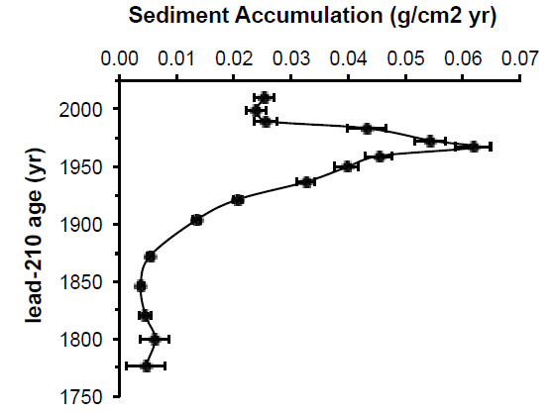
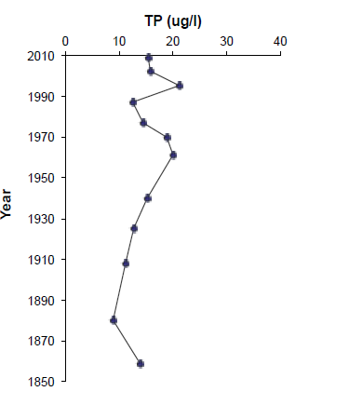
Sediment accumulation rate
Sediment Core Results
Diatom-inferred TP reconstruction
Notes:
The sediment accumulation rate increases beginning in the late 1800s and reaches a peak in the 1960s.
Suggests increased erosional inputs to the lake from the surrounding landscape during this time period.
Diatom assemblages indicate that there was a slight rise in nutrient levels beginning
in the 1960s
P levels have remained slightly elevated since that time.
The timing of the nutrient increase coincides with the peak in inorganic sediment load to Third Lake; the source of the nutrients may be coming from these erosional inputs.
However, the changes in the diatom communities are subtle, so any nutrient increases were not enough to substantially alter the diatom assemblage in the lake.

Slide 9
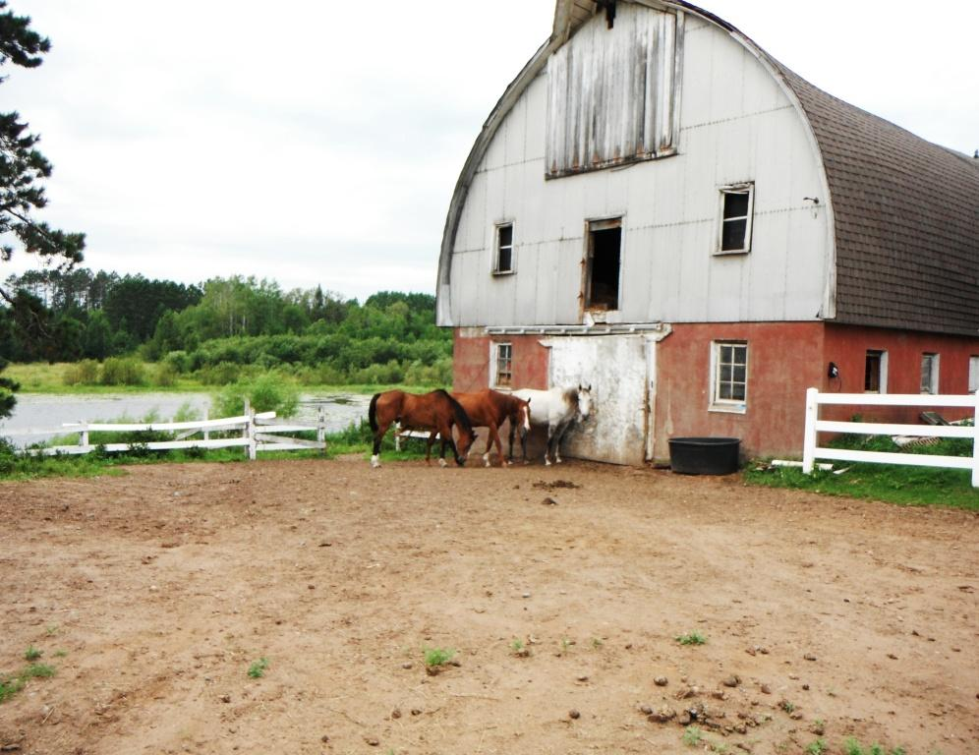
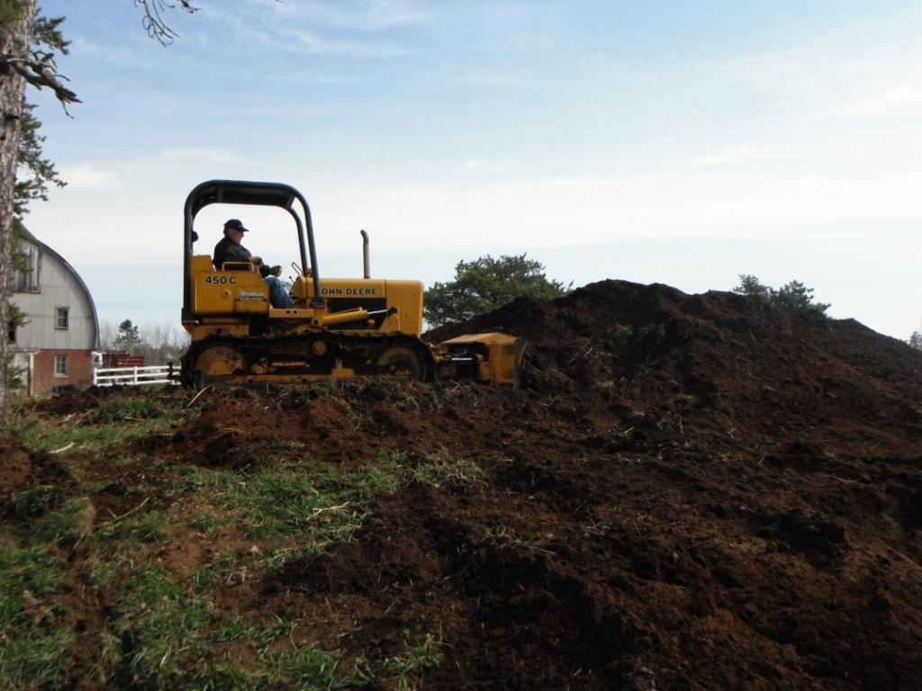
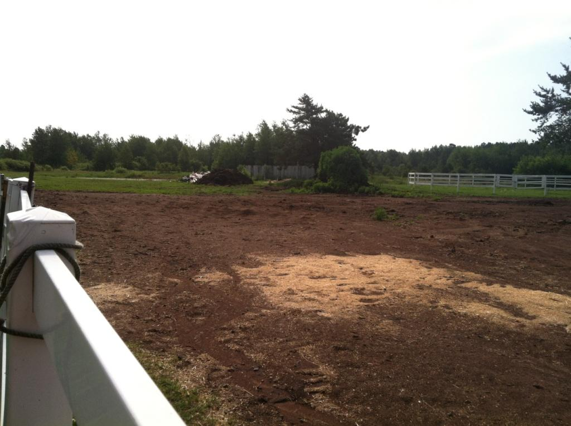
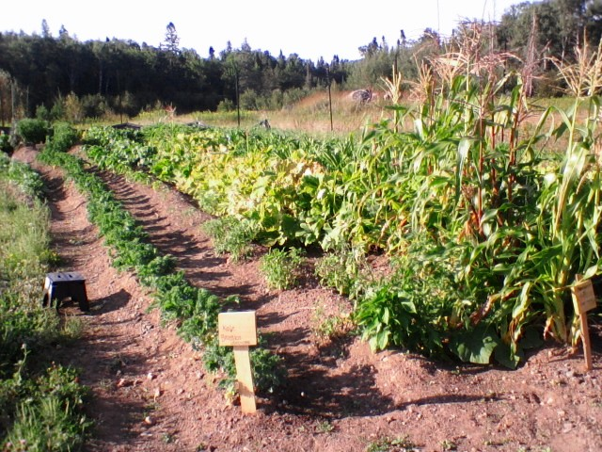
I
Notes:
Photo 1: Site visit to identify NPS on the horse farm. Manure piles close to shore, roof runoff, erosion. Good working relationship with farmer
Photo 2: No grant funding to move manure. The Journey Garden is a demonstration garden for Ojibwe School students. They paid for amnure removal as they needed a cheap, accessible source of fertilizer.
Photo 3:New manure pile being deposited farter away from Third Lake, but not too close to Second Lake. Plan to communicate with farmer to have manure removed more often.
Photo 4: Happy Journey Garden

Slide 10
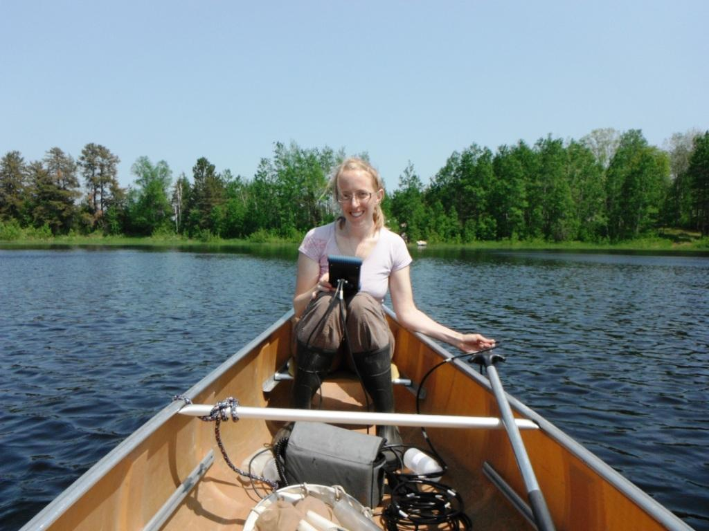
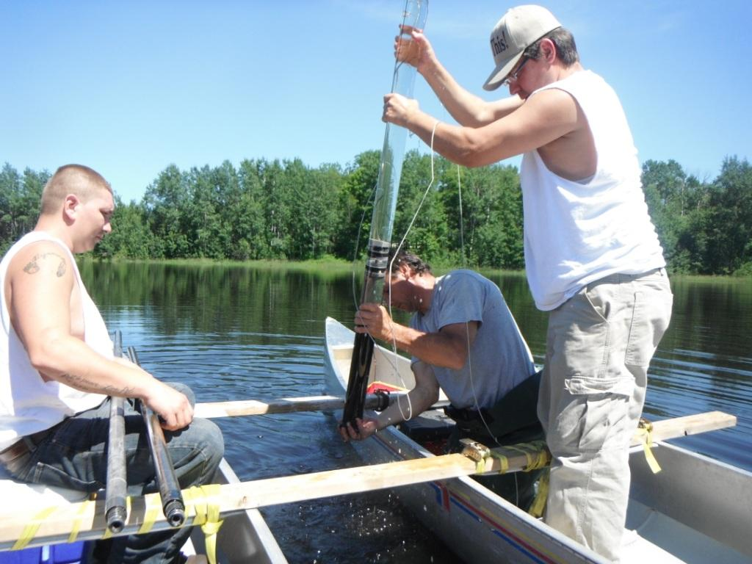
Alum Dosing
Bench Test: Revealed a buffer was needed to prevent lake pH from dropping to toxic levels
Sediment Core: Test for mobile P to determine accurate alum/buffer dose
Targeted Monitoring
Physical: Secchi depth, general chemistry, color, alkalinity/hardness, nutrients, vertical profile of DO, temp, turbidity, and conductivity
Biological: algae, zooplankton, aquatic vegetation, fish
Notes:
Targeted monitoring 2010-2013
Other alum studies only look at changes in surface water – but biggest reductions in P may be in anoxic zone.
We sample at surface, two points of major change in oxycline, and 1 sample at greatest depth
Also sampled:
Sulfate. Rose after alum treatment
Fish in 2010. Found abundant small bluegill, too small to be attractive to people who fish
Comprehensive plant list of the lake to see how it may change with improved water clarity
Sediment nutrients to see if there were any differences in the lake based on proximity to horse farm – didn’t find any differences.
Goals:
Reduction in chlorophyll a concentrations;
Increase in water clarity (decreased turbidity and total suspended solids, increased Secchi depth);
Lessening the 1.5m-deep anoxic layer at the bottom of the lake;
Preventing high pH (>9) in summer months;
Higher zooplankton diversity and larger zooplankter body size that may result from nutrient load reduction;
Increase in species richness, diversity, and abundance macrophytes

Slide 11
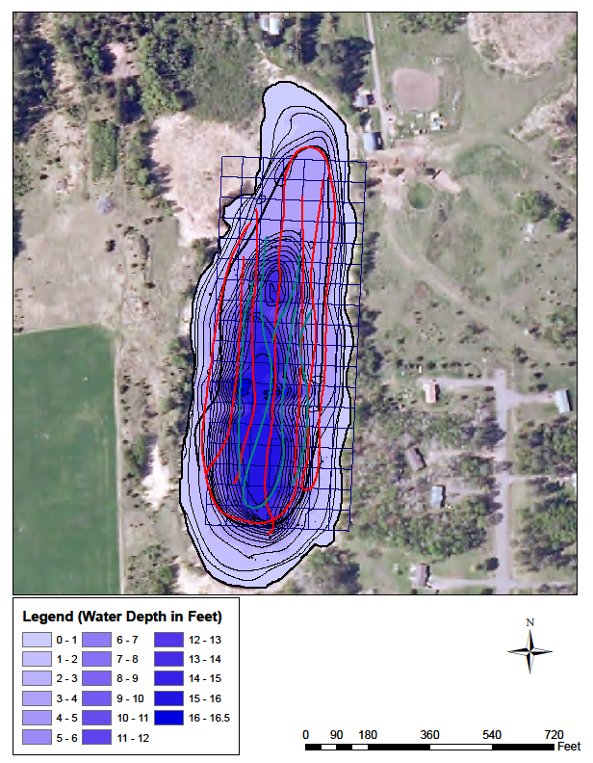
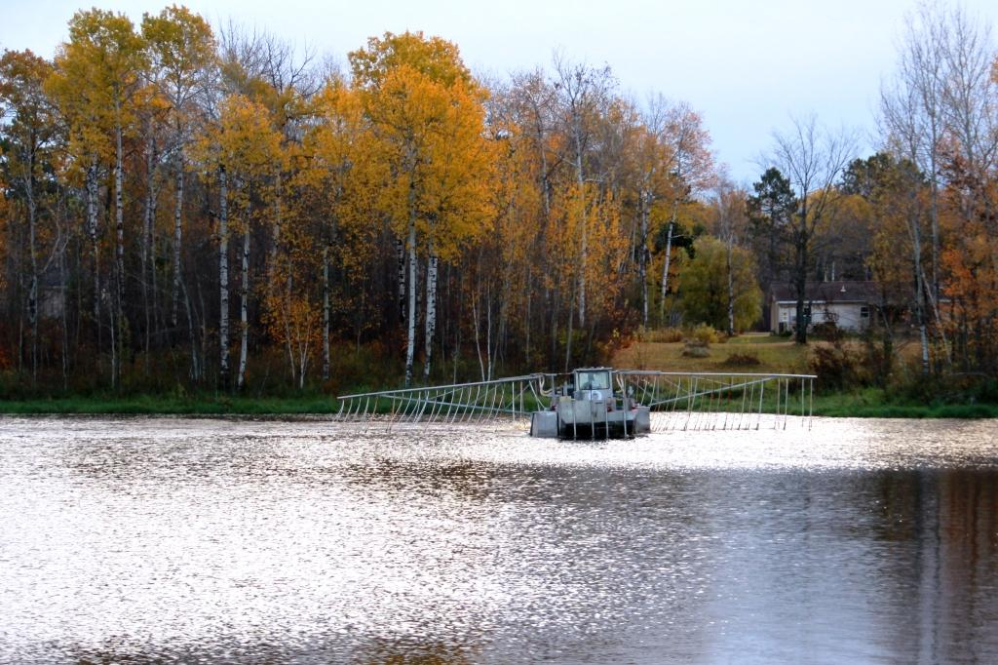
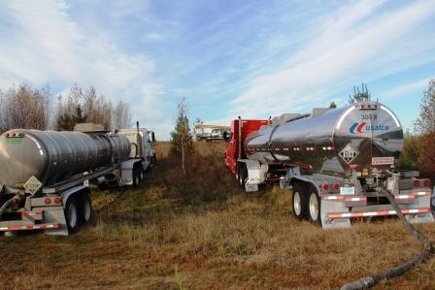
Alum Treatment
Notes:
Bathymetric map – red lines are one pass, blue lines are second pass with barge. No littoral application
Applied alum 1:1 with buffer based on dose calcs from Osgood Consulting
Continued hypolimnetic sampling in 2013
Surprising drawback to alum dosing – SAV survey post-alum showed a marked increase in diversity and extent. BUT, curly-leaf pondweed was abundant. Theorize that it was already in the lake, but increasing water clarity gave it a leg up to expand its population.

Slide 12
Notes:
Significant decrease in hypolimentic TP during the growing season. Didn’t see much change in Secchi depth, will continue to monitor.
Percent change in from Aug pre-alum to Aug post-alum TP is 81%. Goal was 90%, so we will continue to monitor.

Slide 13
Average Monthly Chlorophyll a in Third Lake,
Before and After Alum Treatment
Notes:
Limnetic chlorophyll a also decreased after the alum treatment. Waiting on October 2013 data from Elaine to complete regression so the 2013 R squared doesn’t equal 1.
In absence of 2013 October data, the decrease is not statistically significant. Will need more data to see if this downward trend holds.

Slide 14
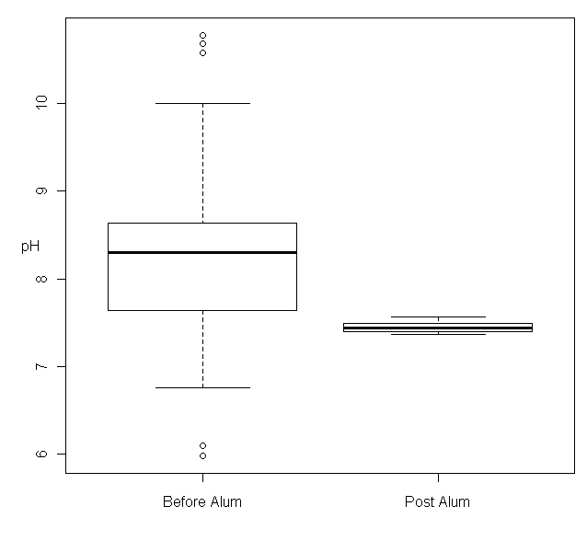
Alum Treatment Effects on Limnetic pH
p = 0.036
Notes:
Limnetic pH was lower in 2013 than in other years, except for 2012 (flood). Could indicate less algae in the limnetic zone.
August is when lake is most stratified
Slight difference in limnetic pH after alum treatment when 2012 data removed – anomalous because of flood.
Hard to know if pH changes a legacy of flood or of alum treatment?

Slide 15

Questions?
Notes:
Long-term goals:
Remove impairments
Meet lake-specific nutrient criteria
Fisheries management

