Slide 1
Prince George’s County, Maryland
Clean Water Partnership
Stormwater P3 Program

Slide 2
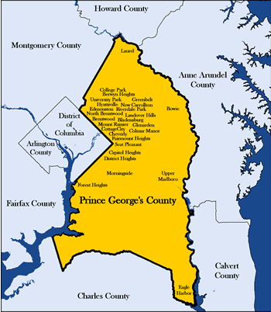
Chesapeake bay watershed
Prince george’s county, Maryland
  Population: 900,000
  500 square miles
  Urban, Suburban, Rural
  Three major rivers
  Birthplace of Low Impact Development (LID)

Slide 3
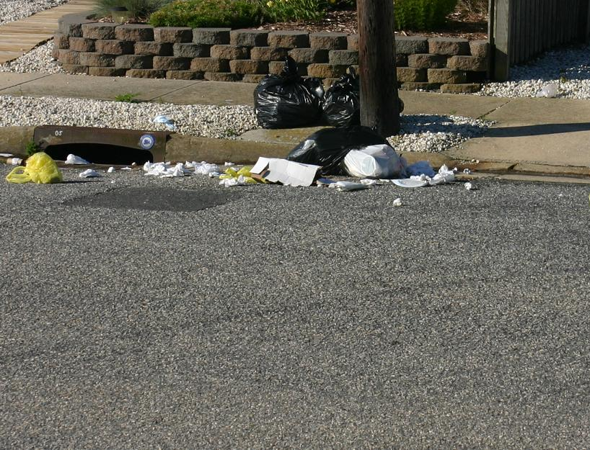
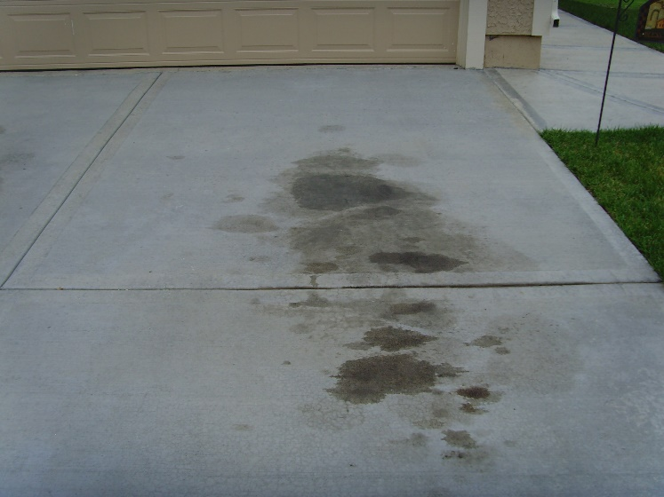
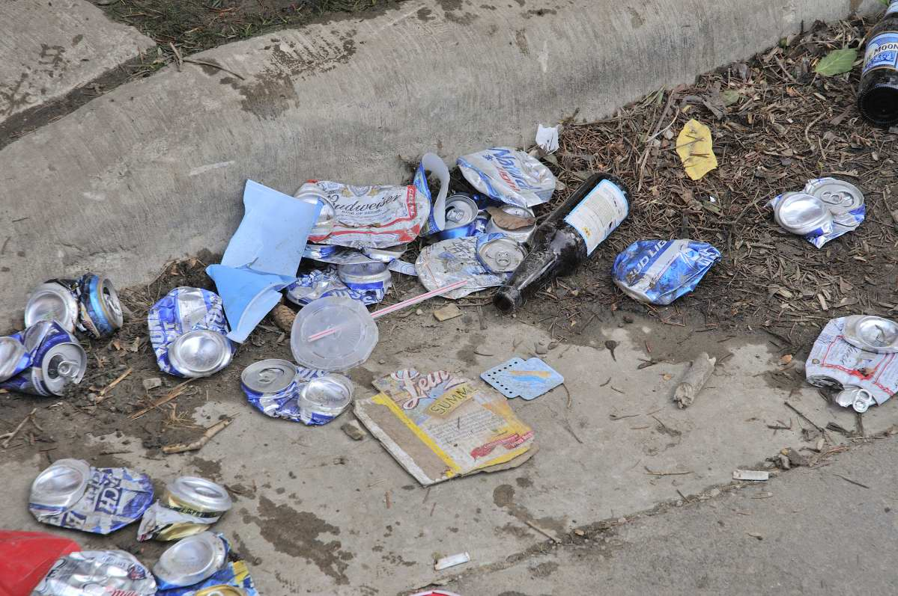
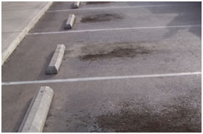
Neighborhood pollution increasing
Must address Polluted Runoff

Slide 4
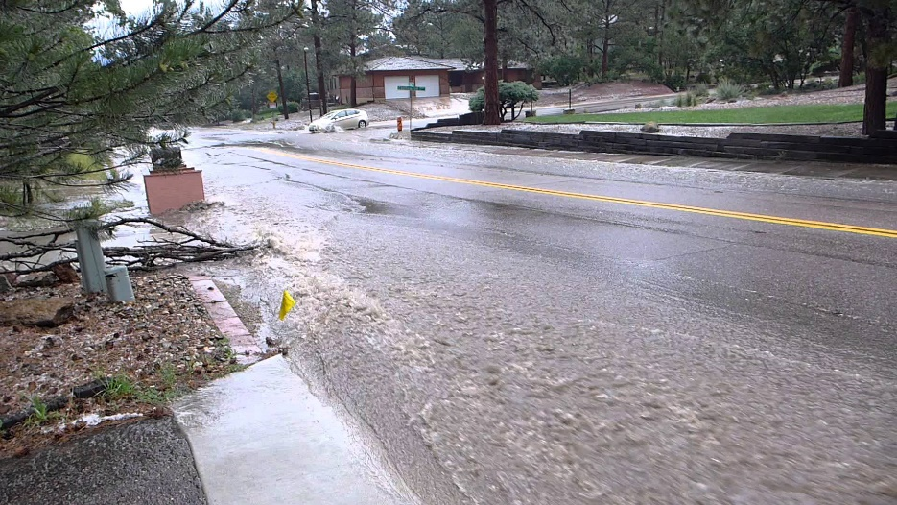
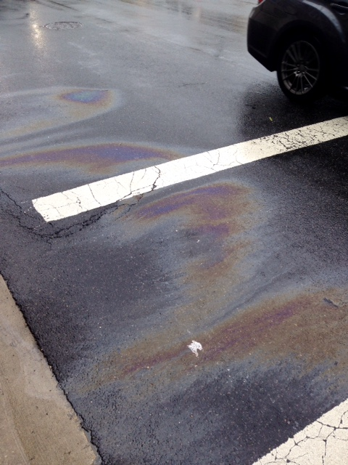
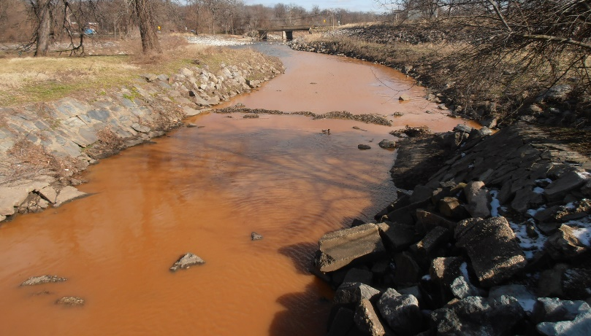
Neighborhood pollution increasing
Must address Polluted Runoff

Slide 5
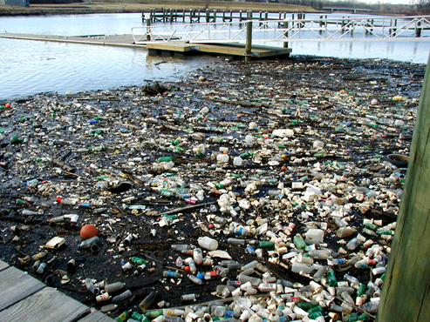
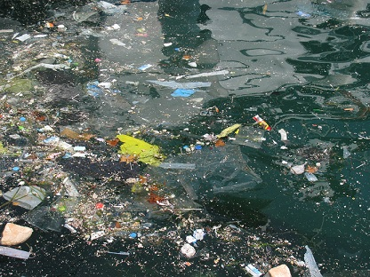
New clean water act mandates
Must address Polluted Runoff

Slide 6
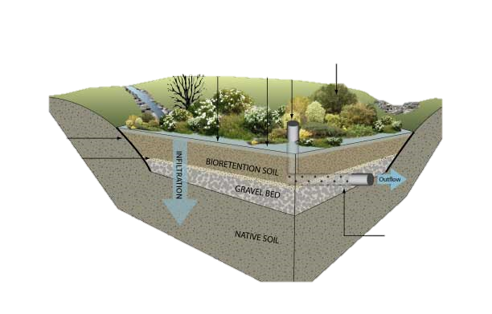
Clean water through retrofits
Permeable pavement

Slide 7
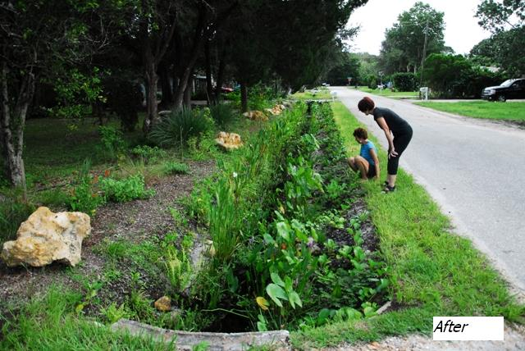
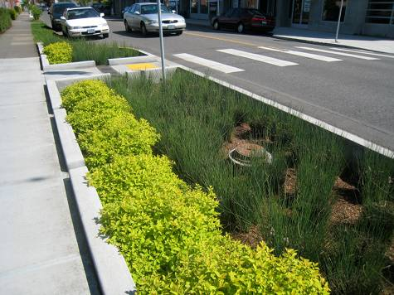
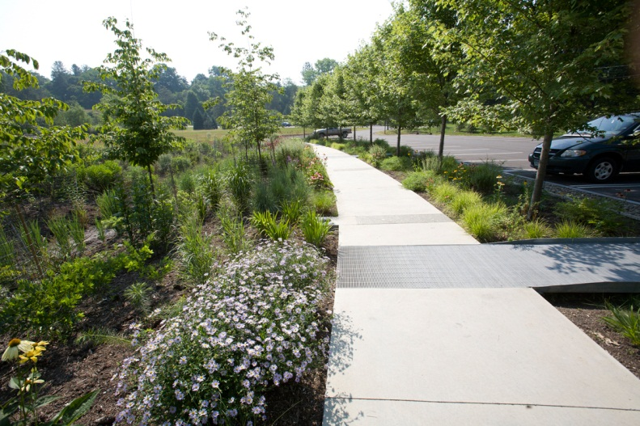
Clean water through retrofits
bioswales

Slide 8
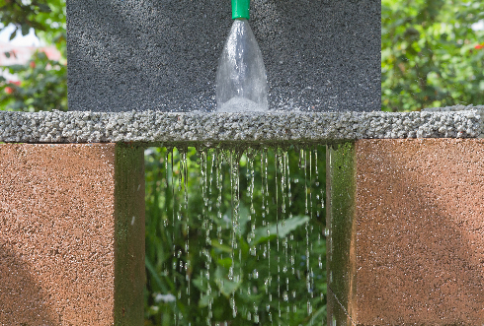
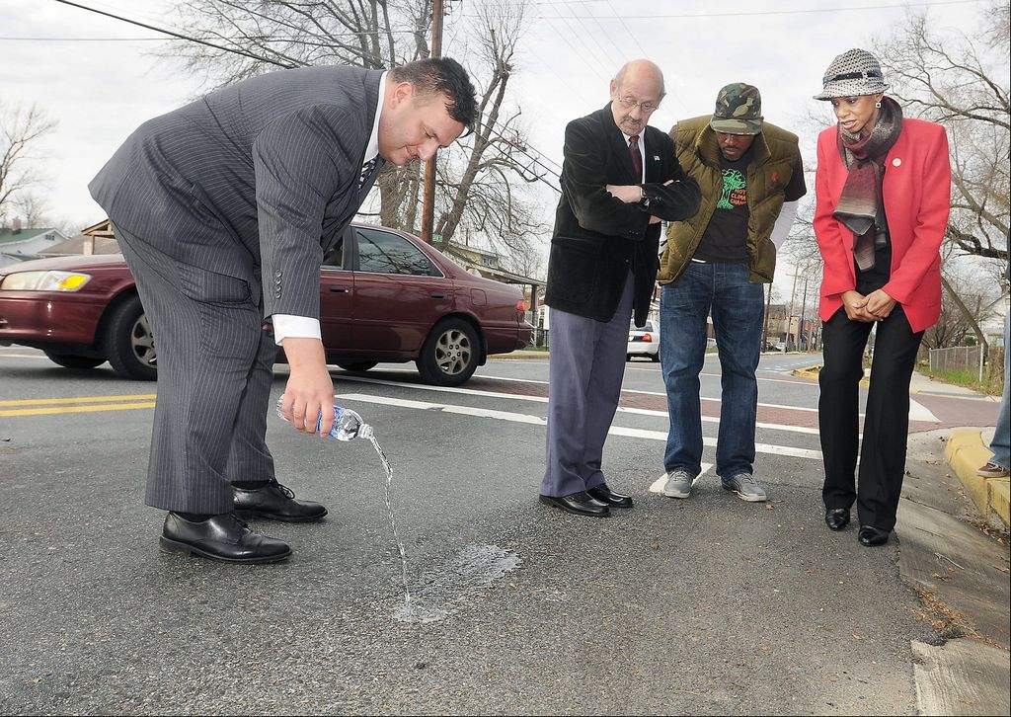
Clean water through retrofits
Permeable pavement

Slide 9
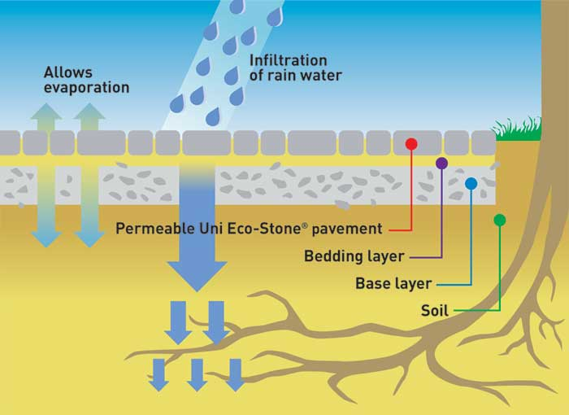

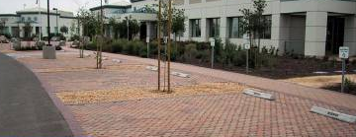
Clean water through retrofits
Permeable pavers

Slide 10
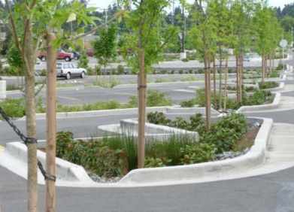
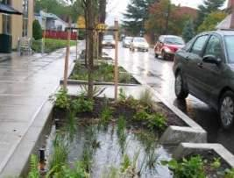
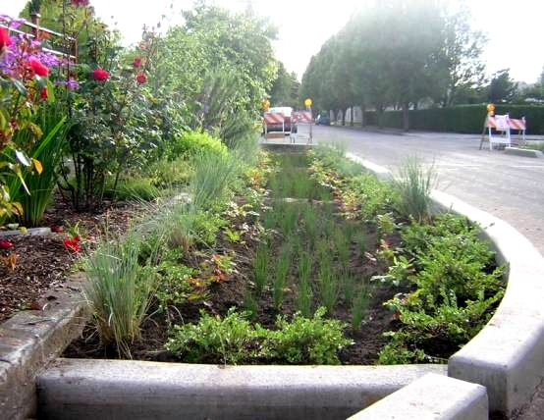
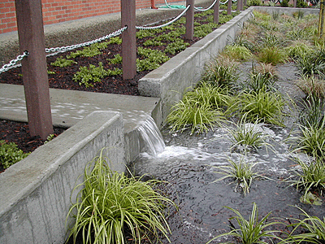
Clean water through retrofits
Treebox raingardens

Slide 11
New clean water act mandates
EPA Sets ambitious goals
Mandate for Prince George’s County
    Retrofit 15,000 impervious acres by 2025
  The Prince George’s Model:
    Clean and healthy neighborhoods = clean and healthy waters
    Revitalize older communities
    Lead with innovation
    Grow local economy
    Partner as much as possible

Slide 12
Clean Water Partnership
Local Investment, Jobs, business, development, community wealth
CW Fee $
County
Partner
Master Program Agreement
County - Oversight
Partner - Management
Community
(Partner)
Construction
(Gen. Contractor)
Maintenance
(Gen. Contractor)
Universities
Faith & Nonprofit
Environmental
Job Training
Schools
Mentoring
Towns & Cities
Subcontractors
Suppliers
Materials
Labors
Inspectors
Drivers
Equipment
Subcontractors
Suppliers
Services
Inspectors
Construction
Labors
Equipment
Local Jobs

Slide 13
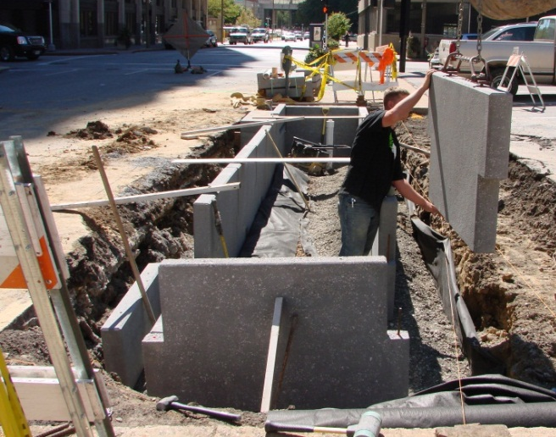
Clean water partnership
Local Investment, Jobs, business, development, community wealth
Partner: Corvias Solutions
Construction: 3 years to retrofit 2,000 acres
Maintenance: 30 years to maintain 2,000 acres
Manage $100M in contracting
  Paid up to 10% fee if performance goals are met:
    Time, budget, procurement targets, business development
    Ramps up to 40% County-based spending
Will “race” to 2000 acres vs DoE Capital Projects team

