Slide 1
Lake-Specific Nutrient Standards and ATTAINS
Kari Hedin
Nancy Schuldt
Fond du Lac Reservation

Slide 2
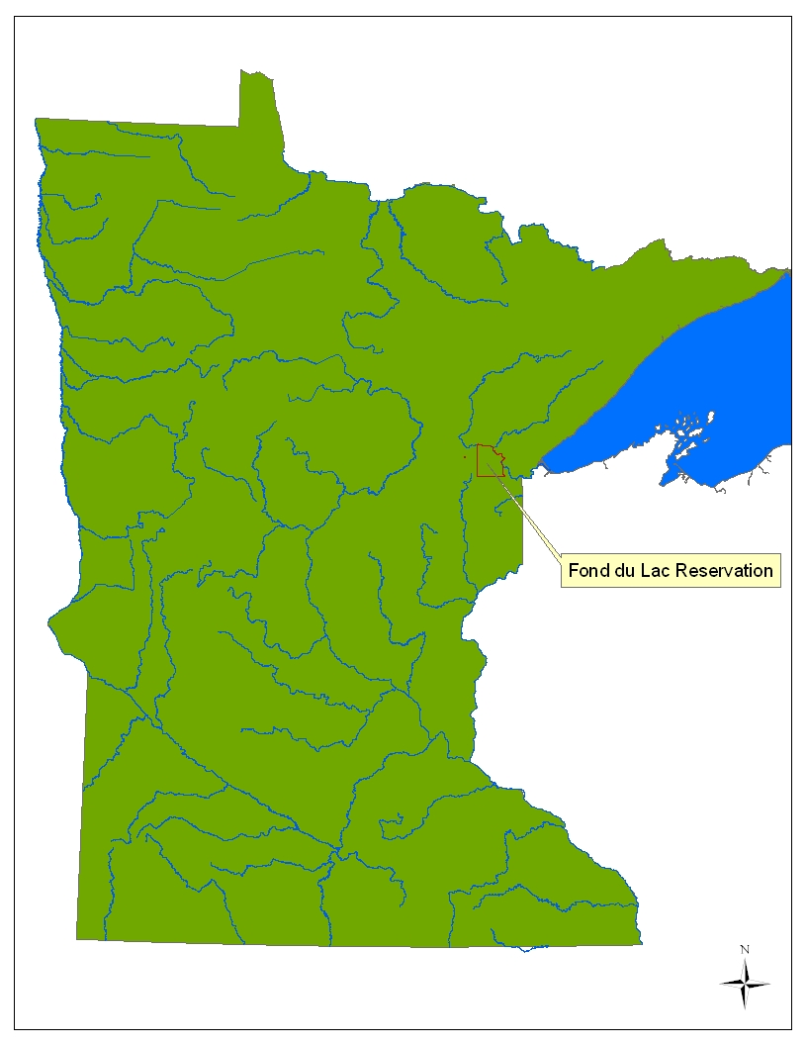

Slide 3
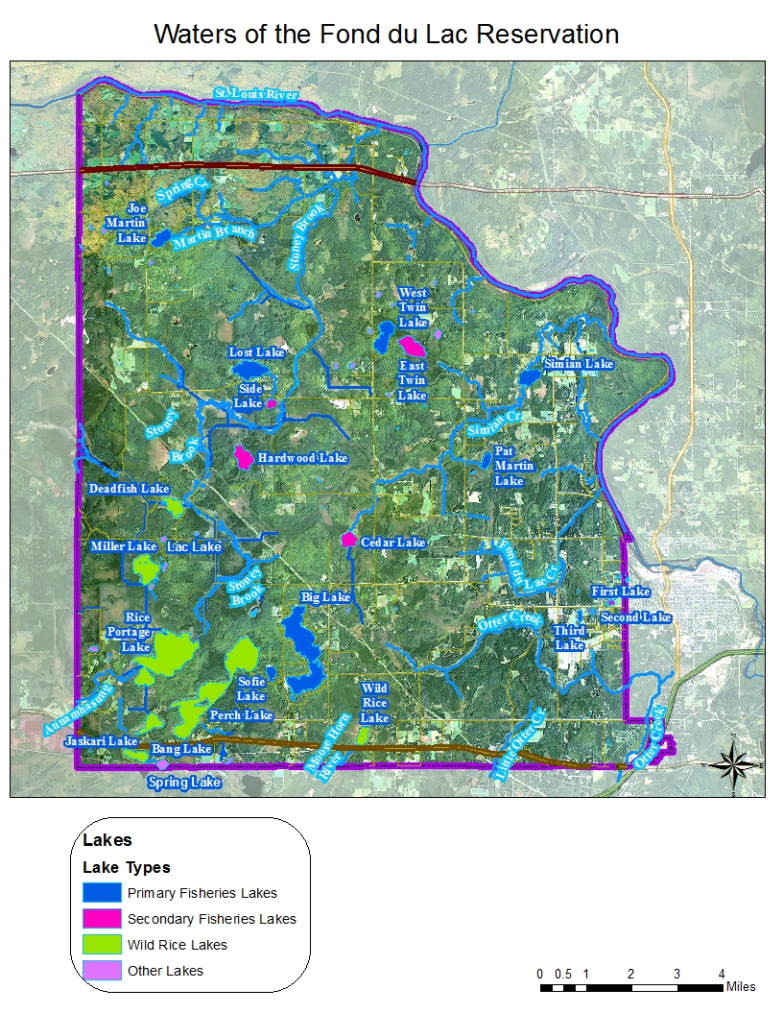
Notes:
Nine main fisheries lakes
Big
Simian
Lost
Pat Martin
Joe Martin
Third
Perch
First
Second

Slide 4
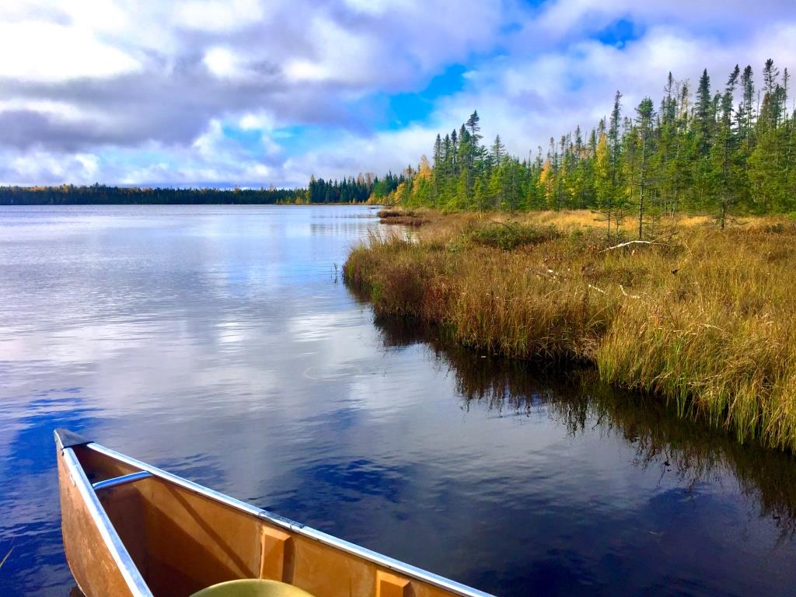
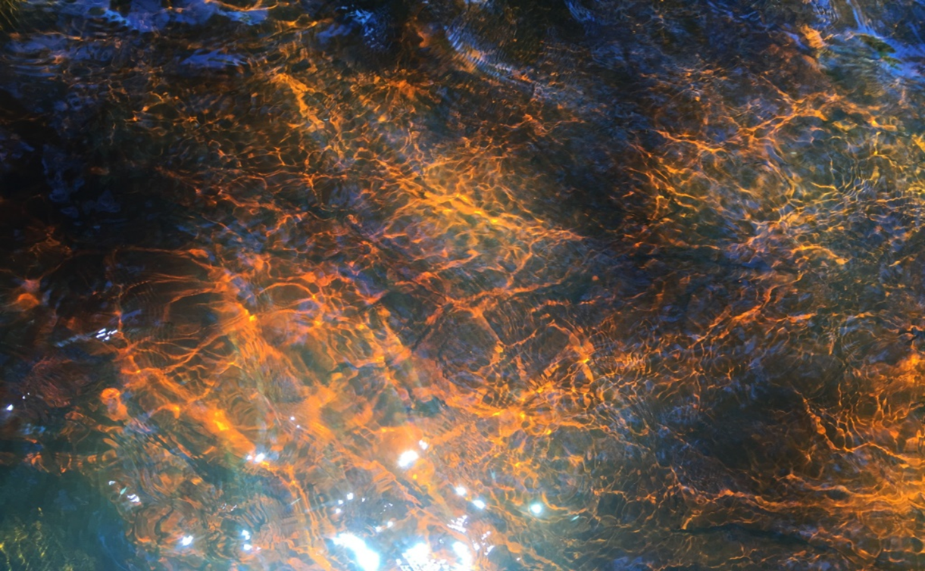
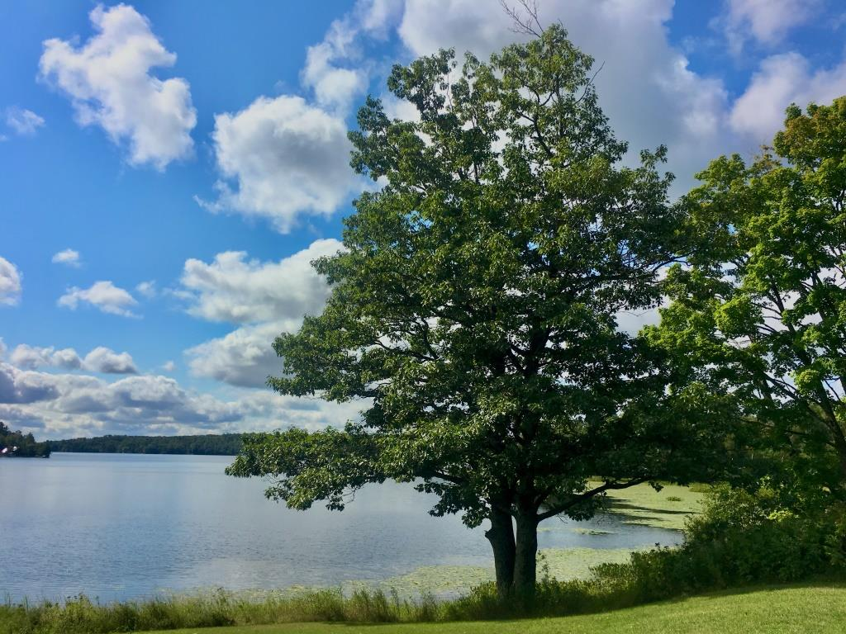
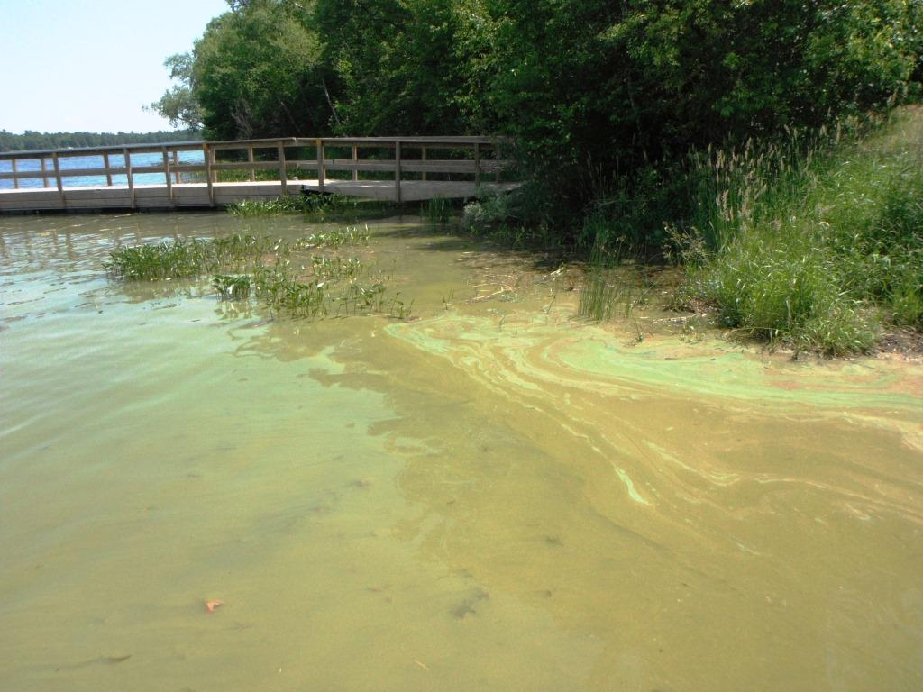
Notes:
Main factors that impact FDL water quality: low human impacts and shallow, colored waters.

Slide 5
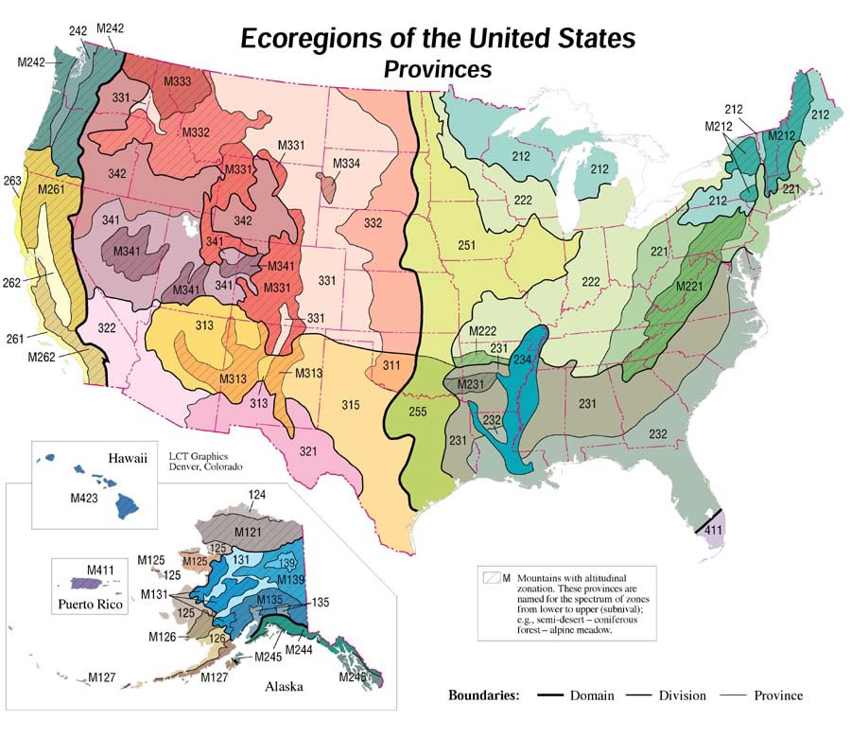
USFS, USEPA
Notes:
Canadian shield, boreal forest, rocky soil
Deep, clear oligotrophic lakes

Slide 6
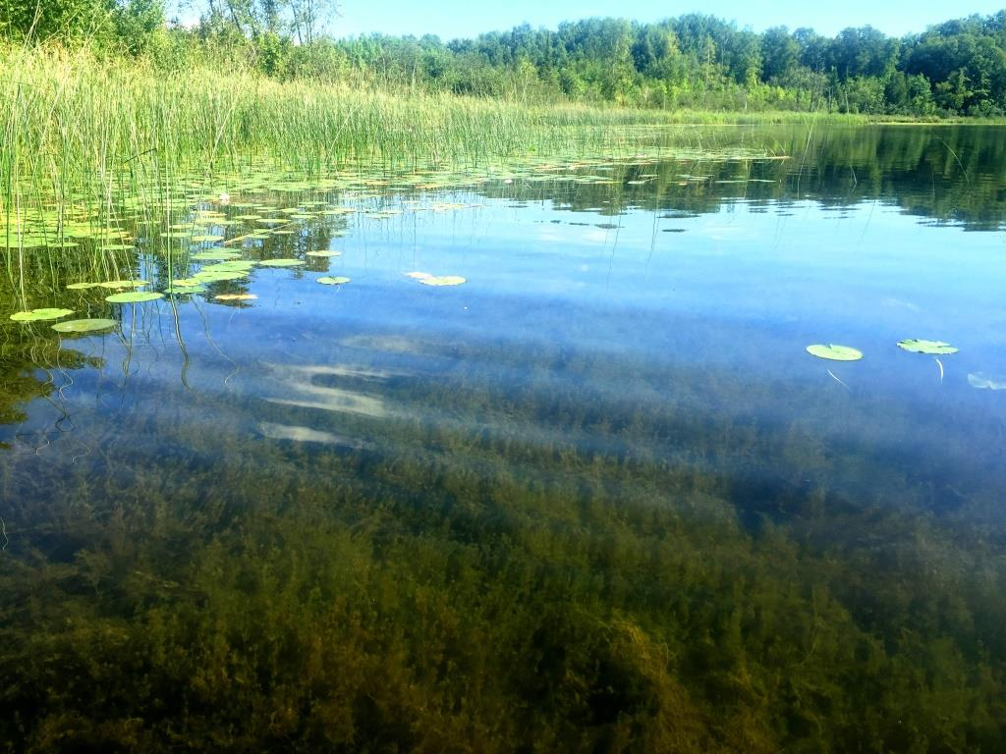
MN State Standards, Northern Lakes and Forests Ecoregion
Meant for the many oligotrophic lakes in the NLF, but FDL’s lakes often don’t meet these criteria thresholds because they are minimally impacted, shallow and highly colored.
Notes:
State samples a wide range of lakes to capture the variation in nutrients.
But their standard isn’t a good fit for tribal waters that only capture a subset of that variability.
FDL lakes are unique, and some would end listed as impaired if we applied NLF criteria to them.
Even the state struggles with how to apply the NLF standard to shallow stained lakes.
States have a huge spatial extent but limited temporal variation, while tribes have limited spatial extent and large temporal variation.

Slide 7
FDL’s General Water Quality Standards
Narrative criteria: “Reservation waters shall be free from nutrients (nitrogen and phosphorus) entering the waters as a result of human activity in concentrations that create nuisance growths of aquatic weeds and algae.”
EPA has requested numerical nutrient criteria. Important indicators of designated uses.
Look for the threshold where biological responses change when nutrients increase.
Notes:
Much research on the algae/nutrient relationship has occurred in deep, clear, stratified lakes. The algae/nutrient relationships are very different in shallow, unstratified and stained lakes and not well studied. How do we know what the “expected” conditions for these lakes are in an undisturbed state?
The USEPA has requested that scientifically defensible numerical nutrient criteria be developed to protect designated uses of water bodies (USEPA 2000).
Because designated uses themselves are difficult to directly measure, nutrient levels of water bodies have been suggested as important indicators of designated uses.
Look for the threshold where biological responses change when nutrients increase, because high nutrient levels don’t always indicate impairment.
Take into account that biological responses will vary with nutrients within a given ecoregion.

Slide 8
New in 2018!
Numeric Criteria: “Primary Reservation fisheries lakes will be assessed using nitrogen, phosphorus and chlorophyll a threshold concentrations.”
Calculated using extensive water chemistry data and verified with algal community data from 2006-2016.
Will be used to assess attainment of designated uses. Most restrictive designated use is Aquatic Life.
Notes:
The purpose of developing nutrient criteria, either as an ecoregion or on a lake specific basis, is to ensure all lakes meet their designated uses (USEPA 2000). Except mercury impairments across the board, FDL lakes are currently fully meeting their designated uses, despite having relatively high total phosphorus and Chlorophyll a on occasion.
These thresholds represent a direct measure of the support for aquatic life use designations for the lakes identified, and will be used to assess attainment of designated uses, prioritize restoration projects, and inform §401 certifications.
Because of the wide range of high water quality lakes with varying nutrient levels, researchers have recommended that more sensitive indicators of biological status be used to help determine what appropriate nutrient criteria should be
Soranno suggests lake-specific criteria based on the unique character of FDL lakes, which are also in the NLF ecoregion, that are higher than the more generalized MPCB criteria based on the larger ecoregion. This is due not only to the shallow nature, but also the highly colored open water conditions of the FDL lakes

Slide 9
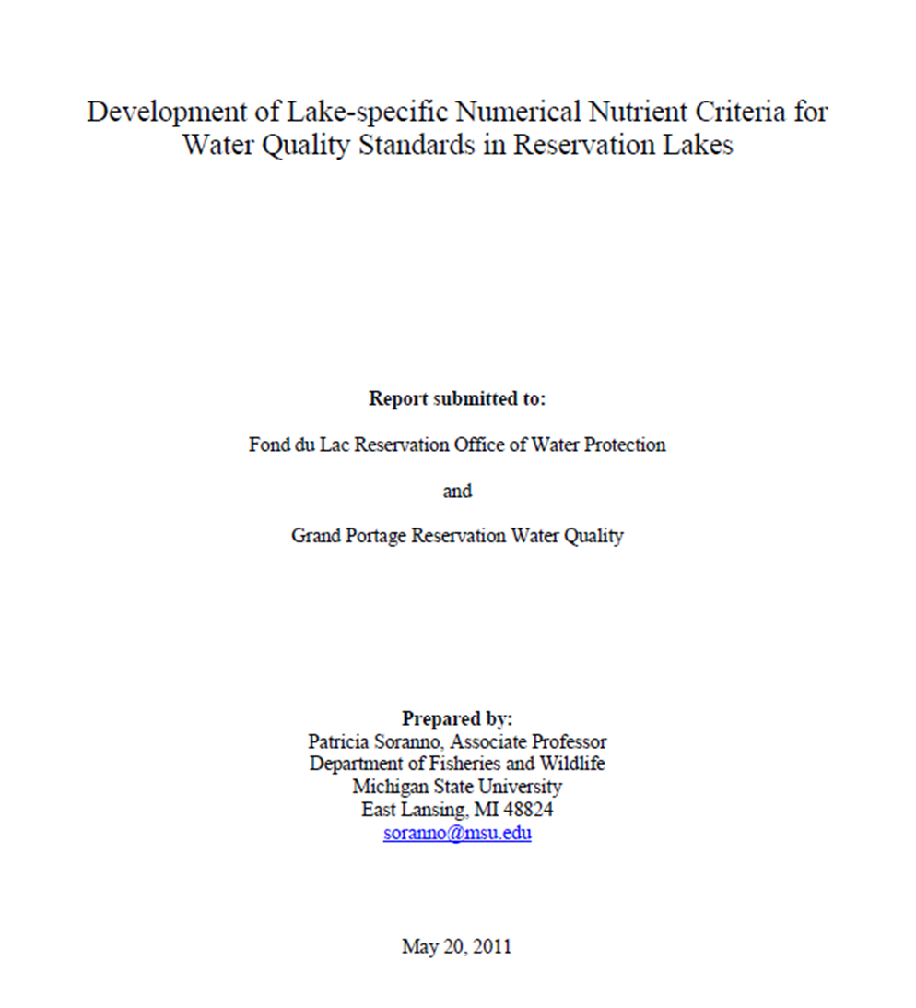
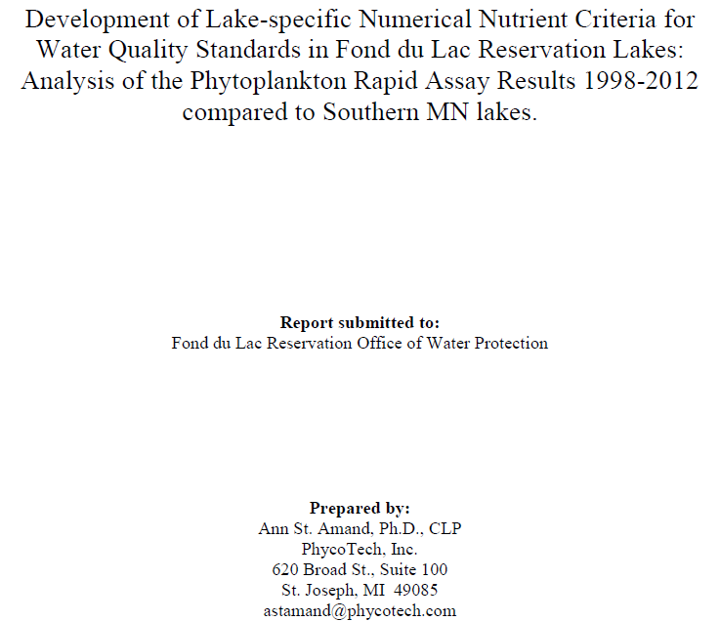
How did we get here?
Notes:
Two studies. One to set nutrient criteria by comparing NLF lake data to FDL data. One to validate those standards by studying biological responses to nutrient levels.

Slide 10
Setting Nutrient Criteria
Assumption: FDL lakes are in relatively undisturbed state.
Using nutrient data from each lake, expected condition is calculated as the full range of expected concentrations for each variable and each lake.
Nutrient criteria calculated as upper 90th percentile of each variable within a season, across all years.
Notes:
Also compared to Grand Portage lakes.
Use the above expected conditions to calculate numeric nutrient criteria for each lake to protect designated uses. The nutrient criterion for each nutrient
in each lake is calculated to be the upper 90th percentile of the samples within a season across all
years.
The acknowledgement of these lakes being in a minimally-impacted state is important because they presently have relatively high nutrient concentrations relative to lakes in the NLF ecoregion. However, these high nutrient levels can be attributed to shallow depth of the water bodies, and high DOC concentrations in the lakes

Slide 11
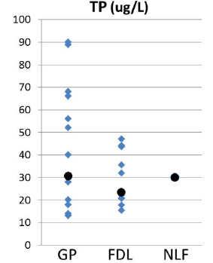
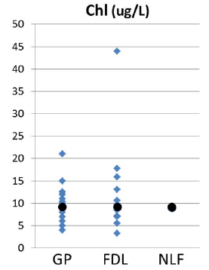
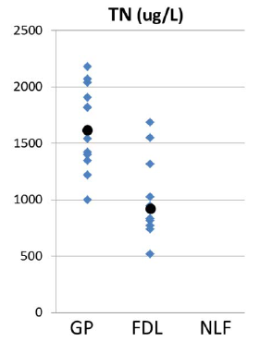
Distribution of Lake-Specific Nutrient Criteria
Notes:
Distribution of lake-specific nutrient criteria for each lake (blue diamonds), compared to median in black and the NLF criterion

Slide 12
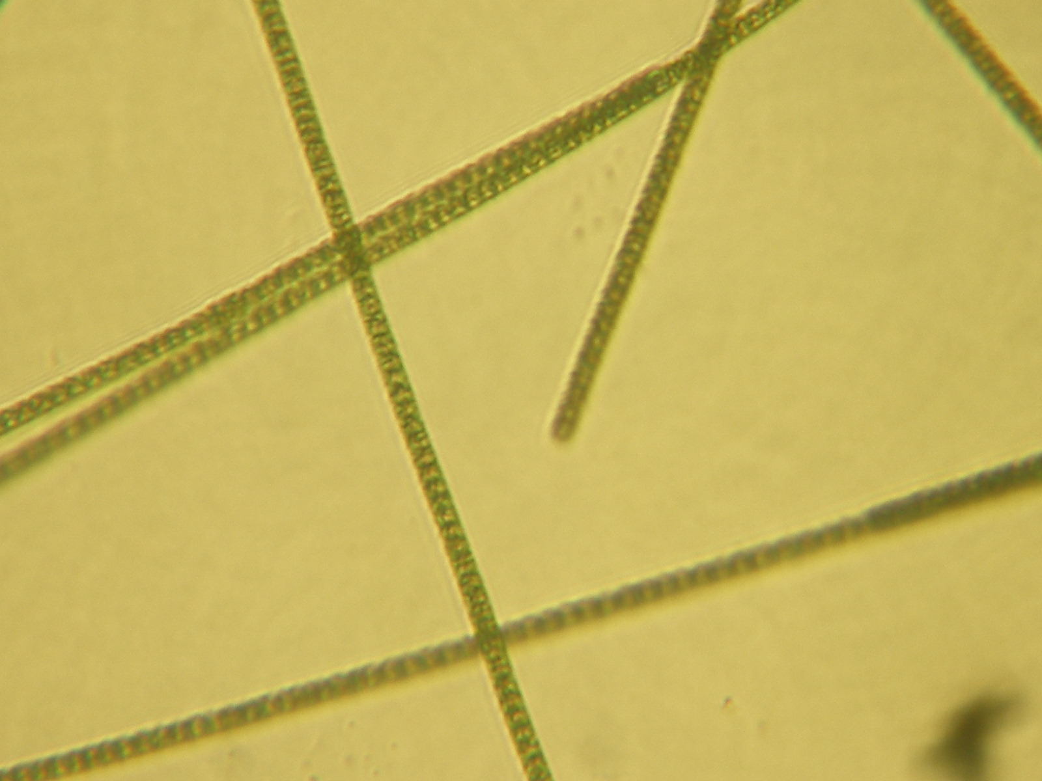
But….need to validate using biological community data
Notes:
Algae are generally considered one of the most sensitive indicators of changes to nutrient loading
Chlorophyll a is a commonly and easily measured water quality indicator. But it is a cumulative indicator that can’t detect subtle shifts in nutrient loading.
Measuring changes in algal compositions over time gives a more sensitive indicator of change in response to nutrient inputs. Chl a as a more cumulative indicator that can’t detect subtle shifts

Slide 13
Phytoplankton Analysis
Algae are generally considered one of the most sensitive indicators of changes to nutrient loading.
Chlorophyll a is a commonly and easily measured water quality indicator. But it is a cumulative indicator that can’t detect subtle shifts in nutrient loading.
Evaluate whether phytoplankton data support the finding that FDL lakes are unique, minimally impacted, and that lake specific criteria are appropriate.
Compare FDL lakes to moderately/highly impacted lakes in Minneapolis metro area.
Notes:
Study compared the FDL lakes to another group of MN lakes that are moderately to highly impacted by human activity, both recreational and
agricultural to examine whether there is evidence that the FDL lakes are impacted by human activities as we know these other MN lakes are.
In this report, Phytoplankton Rapid Assay (PRA) data dating from 1998 to 2012 was used to assess current biological state of the FDL fish lakes in an effort to substantiate the unique character and higher water quality of the FDL lakes.
Assess if the FDL lakes were stable ecologically with relatively high water quality in their algal community and how they compared to lakes of varying productivity.
Do FDL lakes have algal assemblages that are associated with more color, higher WQ?

Slide 14
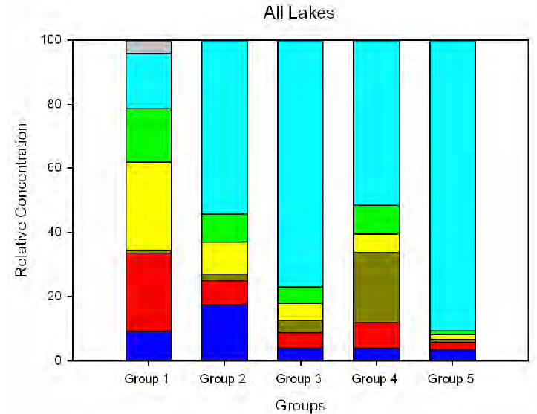
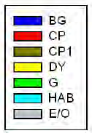
Relative percent algal composition by functional group classification for the five lake groups
Notes:
Human-impacted lakes in groups 2-5 show a larger relative HAB proportion in the algal community. FDL lakes fell into Group 1
The FDL lakes were stable ecologically in their algal community response over the entire study period.
Corroborates conclusions from study on lake-specific nutrient criteria

Slide 15
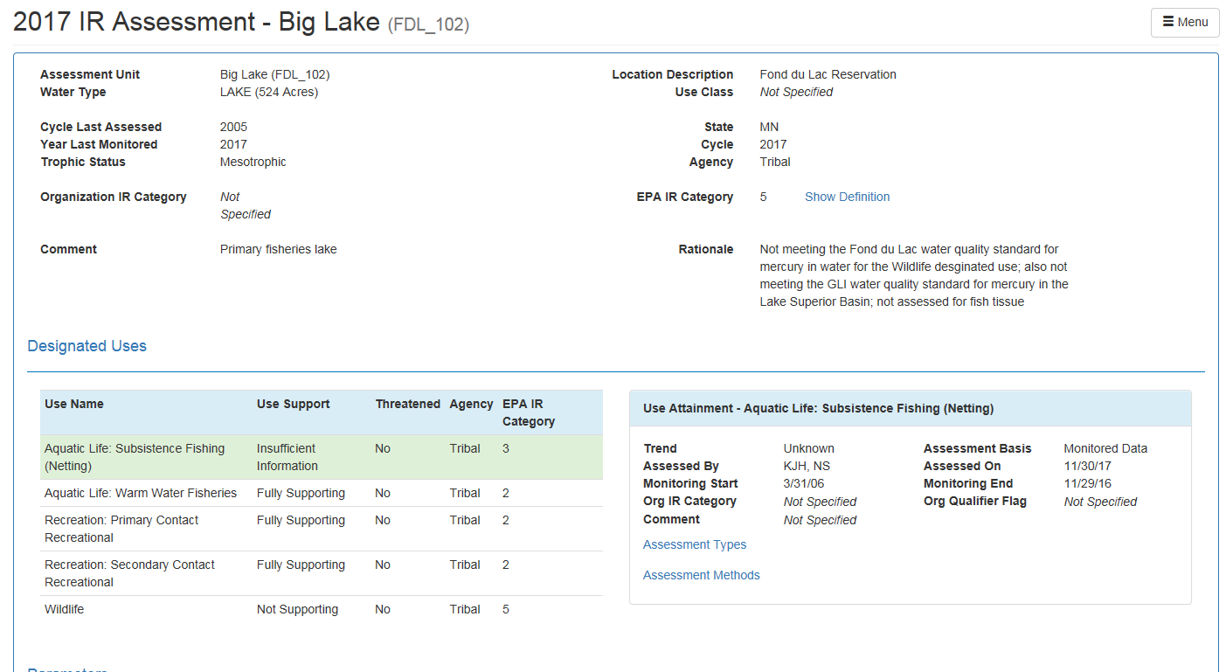
Linking to ATTAINS
Notes:
Triennial review of our WQS was happening this summer, during the same time I was deciding on multiple approaches to our assessment methodology for TP, Chl a and TN.

Slide 16
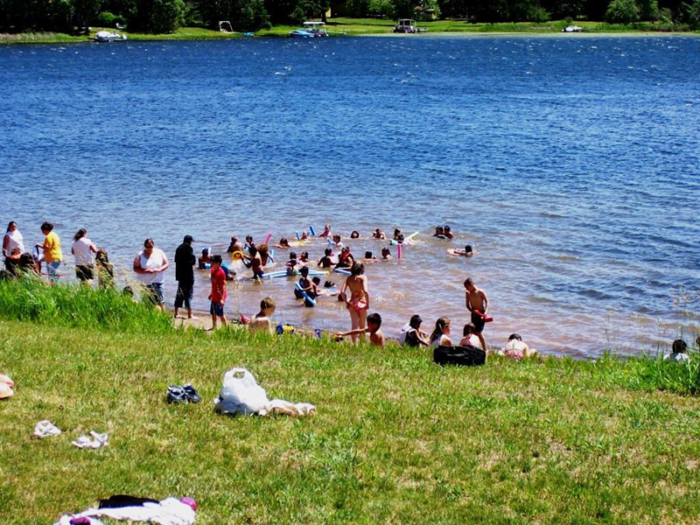
Assessment Methodology
Eutrophication standards for lakes are compared to summer-average data. Exceedance of the total phosphorus and either the chlorophyll-a or Secchi disk transparency standard is required to indicate a polluted condition.
Notes:
Mostly we use the approach of >10% exceedance of a given threshold or standard over 10 years.
But our nutrient data is more variable than other parameters, due to weather and seasonal patterns.
Decided to use the state’s assessment approach, since using summer means reduces the variability in our assessment.
This suggests that the best way to track subtle changes in water quality involves multiple indicators, especially when we are trying to manage nutrients before water quality noticeably degrades.
Yearly climate variation (temperature, rainfall, date of ice out) and associated ground water levels should be the most variable driver on the FDL lakes
Consistent with Soranno (2011), nutrients and Chla alone do not reflect the higher, more consistent water quality of the FDL lakes. Phytoplankton data is the most sensitive indicator of water quality available.

Slide 17
Total Phosphorus Data
Lake | TP Threshold (mg/L) | TP Mean (mg/L)
Joe Martin Lake | 0.015 | 0.014
Big Lake (North Basin) | 0.018 | 0.015
Big Lake (South Basin) | 0.021 | 0.015
Pat Martin Lake | 0.021 | 0.019
West Twin Lake (North Basin) | 0.022 | 0.020
Lost Lake | 0.023 | 0.020
West Twin Lake (South Basin) | 0.024 | 0.020
Perch Lake (North Basin) | 0.032 | 0.025
Sofie Lake | 0.036 | 0.019
Third Lake | 0.044 | 0.025
Perch Lake (South Basin) | 0.044 | 0.032
Simian Lake | 0.047 | 0.039
Comparison to MN State Standards for Similar Lakes
Eutrophication Standards for Class 2Bd lakes, shallow lakes, and reservoirs:
Northern Lakes and Forests Ecoregion
TP: 0.03 mg/L
North Central Hardwood Forest Ecoregion
TP: 0.04 mg/L
Notes:
Because shallow lakes mix more frequently, they may be subject to larger numbers of outlier data points in which a sample taken during a mixing event could be substantially different than a sample taken during a short-term stratification event.
Further justification for using seasonal averages.
Growing season will most greatly influence designated use and perceived water quality. For algae analysis, April, May, and November are all statistically separate from the main summer growing season.

Slide 18
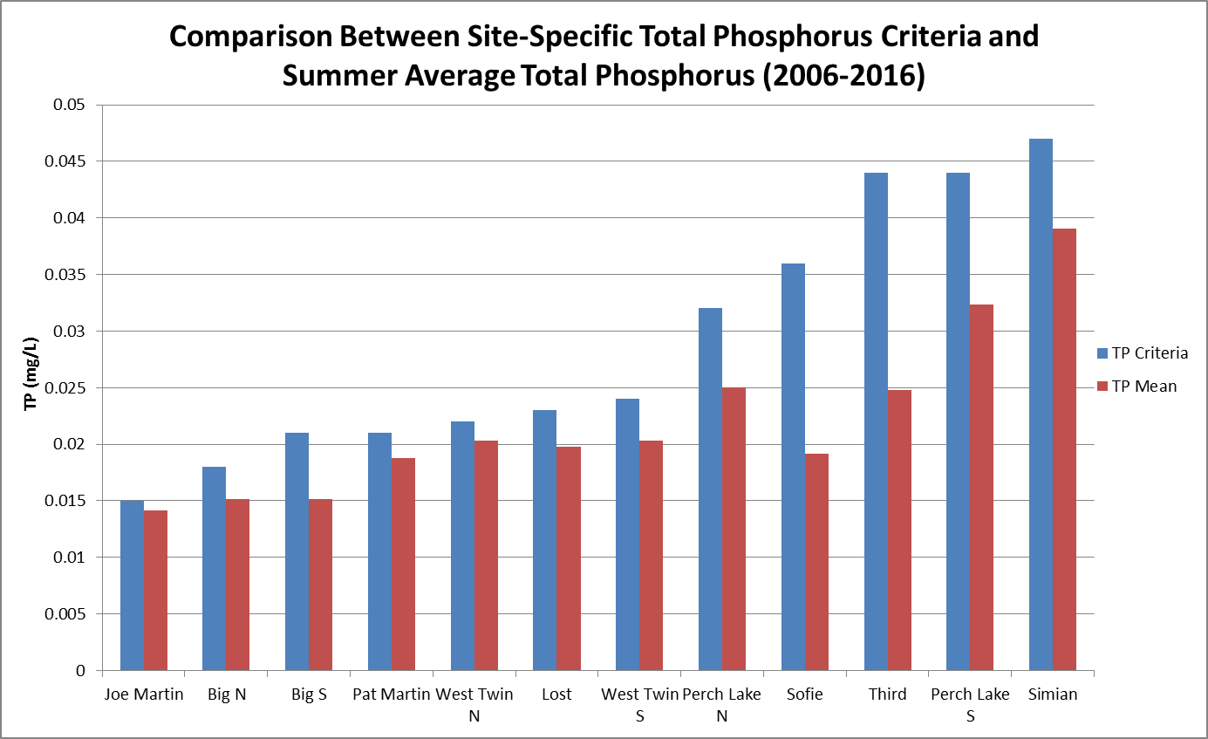
Notes:
Same story for chlorophyll a and total nitrogen
In this report, PRA data dating from 1998 to 2012 was used to assess past and current biological state, and substantiated the unique, higher water quality character
of the FDL lakes.

Slide 19
Chlorophyll a data.
Lake | Chl a Threshold (ug/L) | Mean Summer Chl a (ug/L)
Joe Martin Lake | 3 | 2.95
Big Lake | 7 | 3.22
Pat Martin Lake | 7 | 7.09
Perch Lake (South Basin) | 8 | 5.24
West Twin Lake | 11 | 7.98
Lost Lake | 13 | 9.62
Simian Lake | 16 | 14.86
Perch Lake (North Basin) | 18 | 10.06
Sofie Lake | 33 | 6.78
Third Lake | 44 | 11.97
Comparison to MN State Standards for Similar Lakes
Eutrophication Standards for Class 2Bd lakes, shallow lakes, and reservoirs:
Northern Lakes and Forests Ecoregion
TP: 9 ug/L
North Central Hardwood Forest Ecoregion:
TP: 14 ug/L

Slide 20
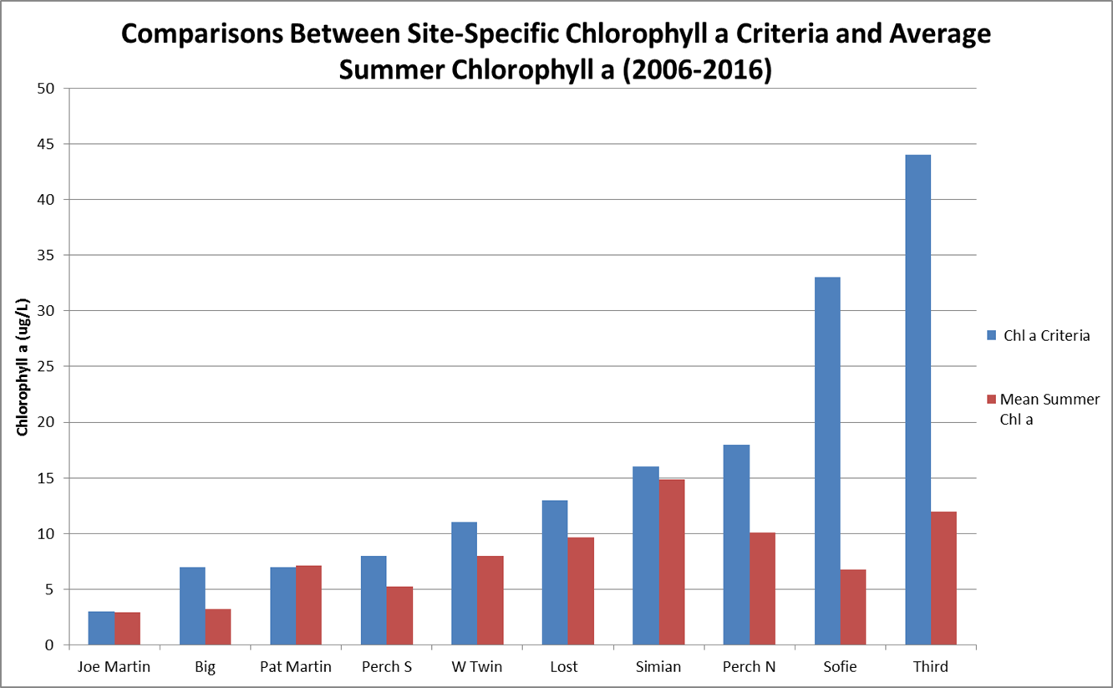

Slide 21
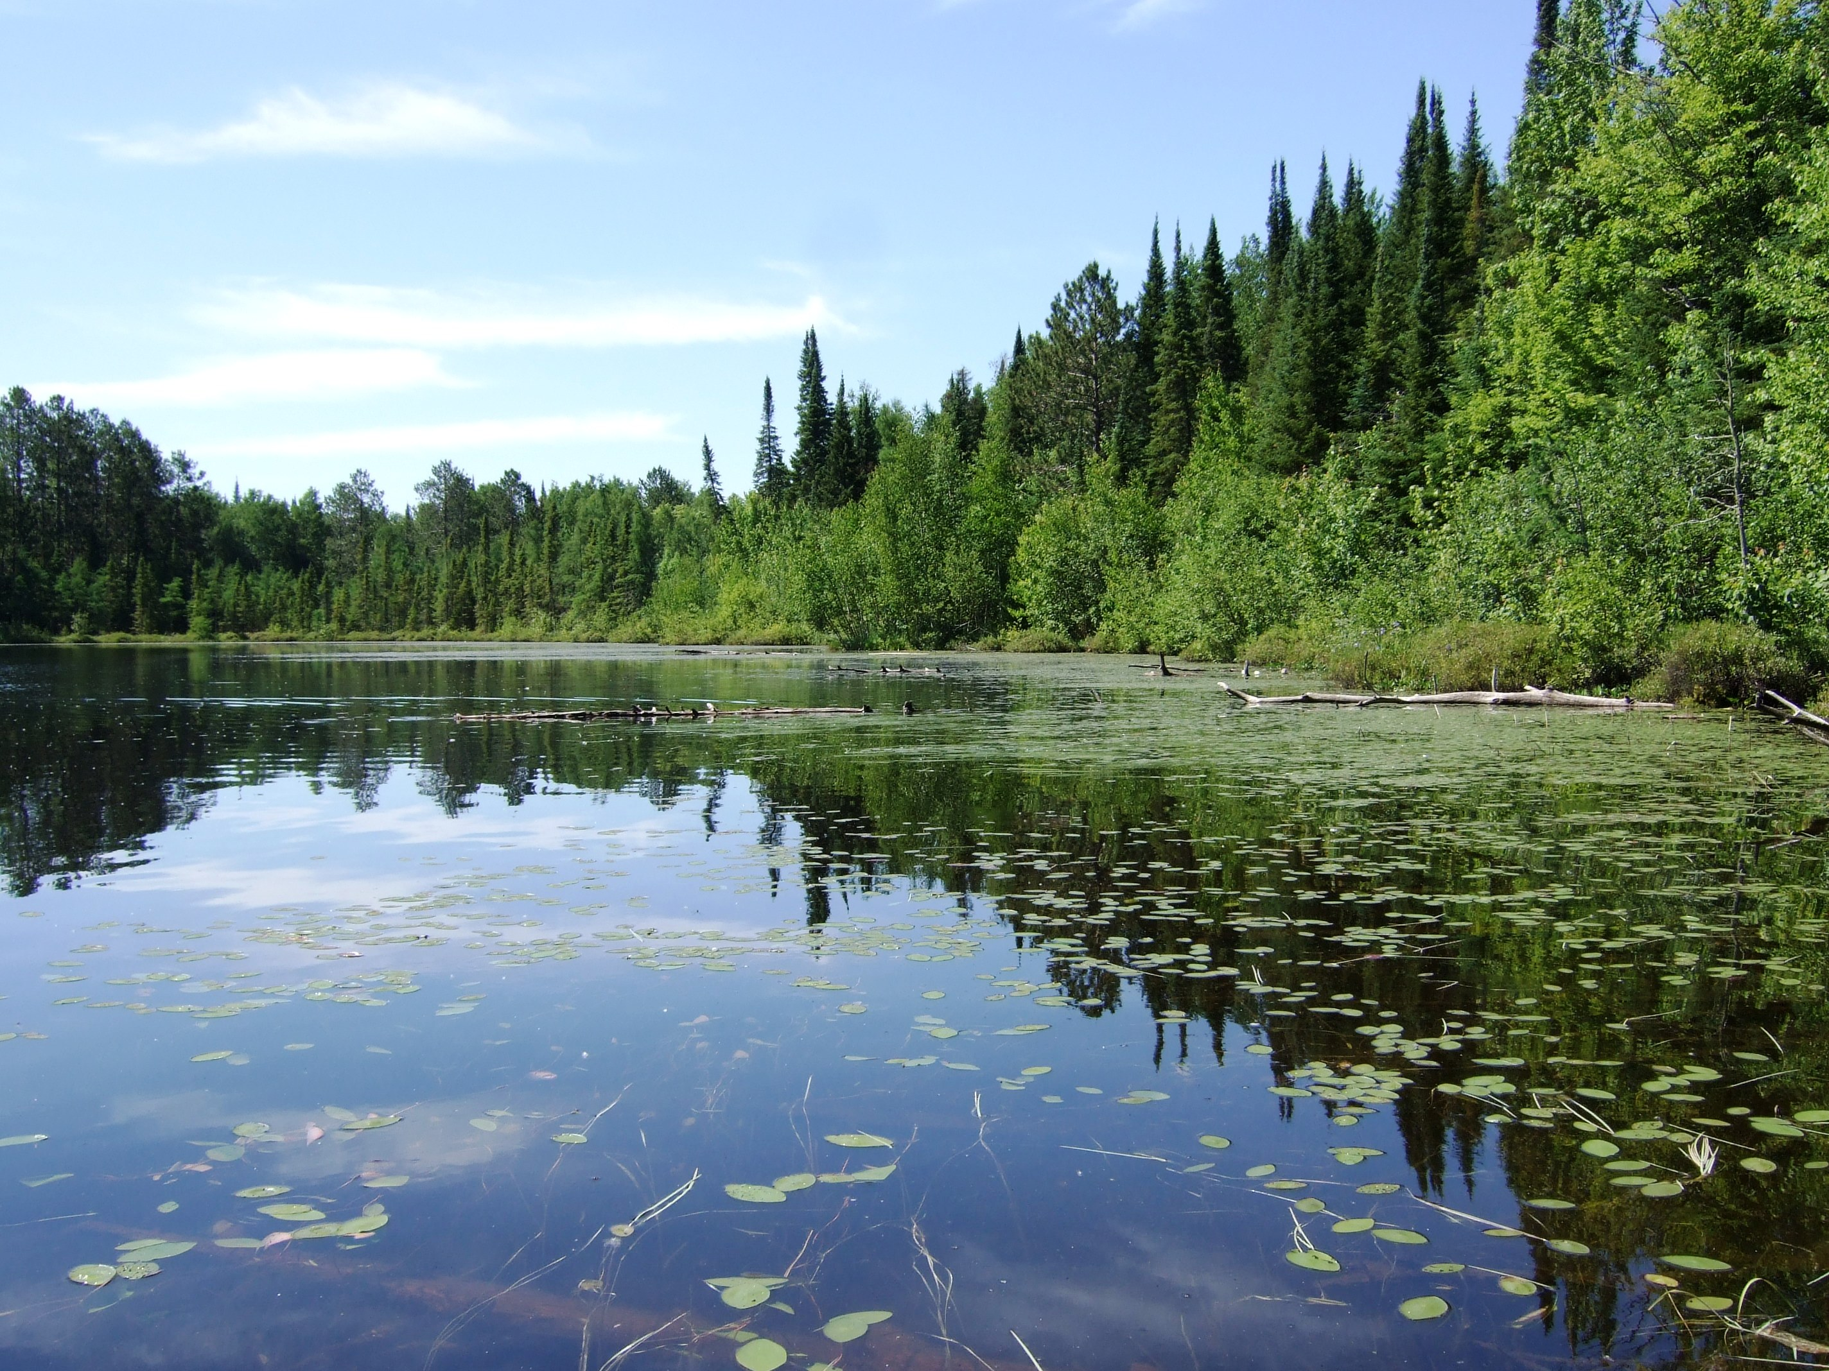

Slide 22
Lake Name | Percent Exceedance for Lake-Specific Phosphorus Criteria Jun-Sept | Percent Exceedance for Lake-Specific Chlorophyll a Criteria Jun-Sept | Percent Exceedance for Lake-Specific Secchi Criteria Jun-Sept | Notes
Big Lake (North Basin) | 13 | 7 | 0
Big Lake (South Basin) | 0 | 0 | 100 | Due to Secchi sitting on lake bottom at 5 ft
Joe Martin Lake | 25 | 46 | 4
Lost Lake | 22 | 23 | 0
Pat Martin Lake | 32 | 31 | 0
Perch Lake (North Basin) | 14 | 13 | 0
Siman Lake | 20 | 38 | 5
Sofie Lake | 0 | 0 | 0
Third Lake | 16 | 0 | 13 | Improved after alum treatment in 2012
West Twin Lake (North Basin) | 29 | 4 | 9
West Twin Lake (South Basin) | 24 | 4 | 5

Slide 23
Total Nitrogen Data (TKN+Nitrate+Nitrite)
Lake | TN Threshold (mg/L) | TN Mean (mg/L)
Joe Martin Lake | 0.618 | 0.445
Pat Martin Lake | 0.739 | 0.625
Big Lake (North Basin) | 0.77 | 0.597
Big Lake (South Basin) | 0.83 | 0.706
West Twin Lake (North Basin) | 0.83 | 0.761
Sofie Lake | 0.854 | 0.727
Perch Lake (North Basin) | 0.944 | 0.758
Lost Lake | 1.025 | 0.894
Simian Lake | 1.352 | 1.114
Third Lake | 1.548 | 0.820
Perch Lake (South Basin) | 1.686 | 1.357

Slide 24
